Slide 1
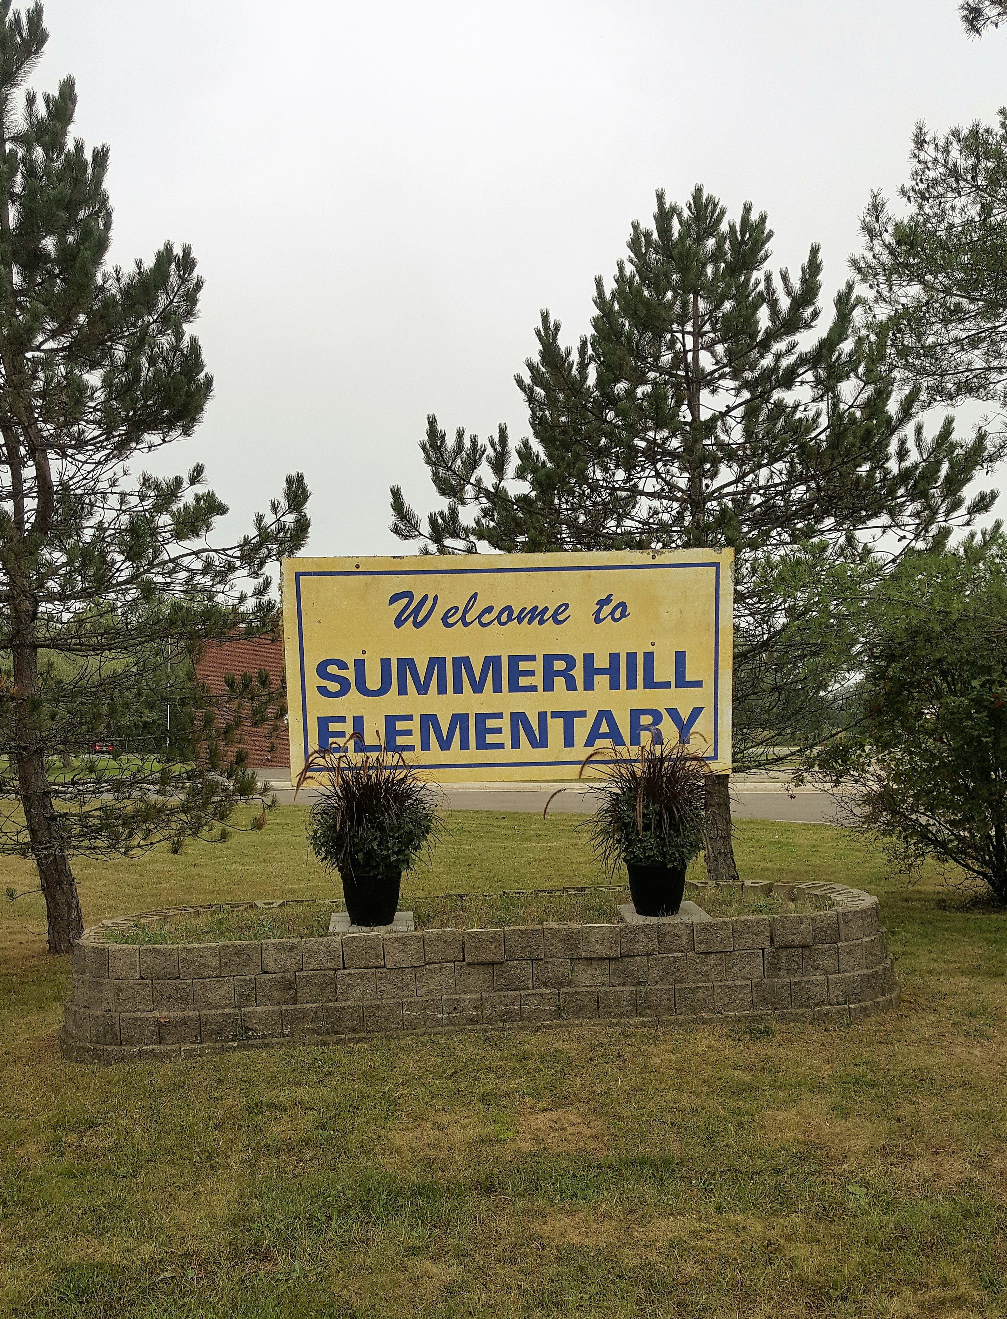
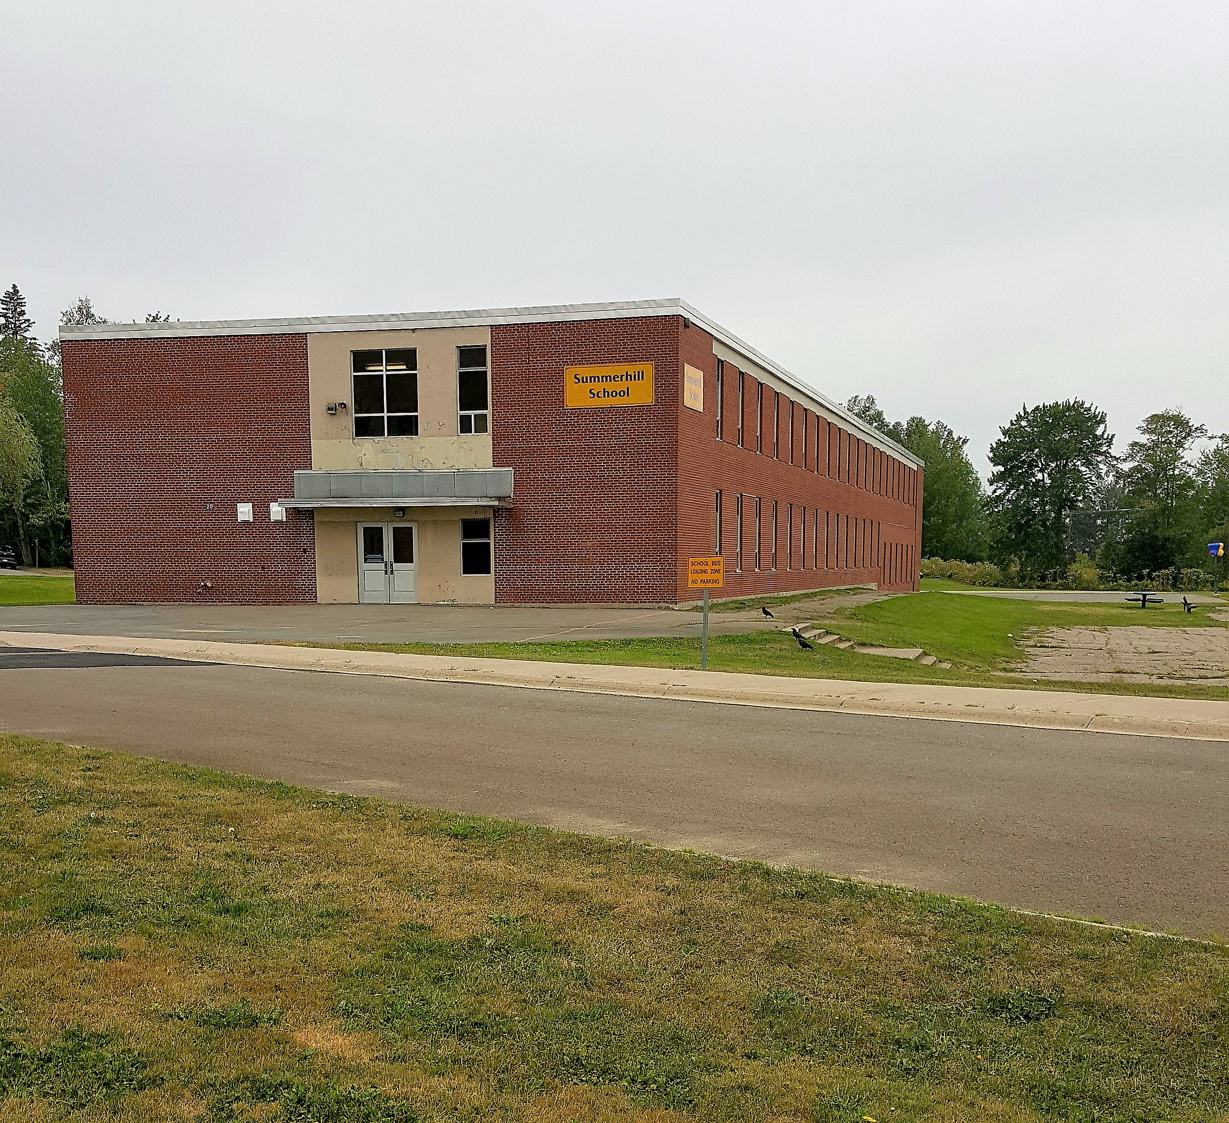
Welcome to Summerhill Street Elementary School

Slide 3
Administration Team - Mrs. Atherton - Principal Mrs. Jordan - Vice-Principal

Slide 4
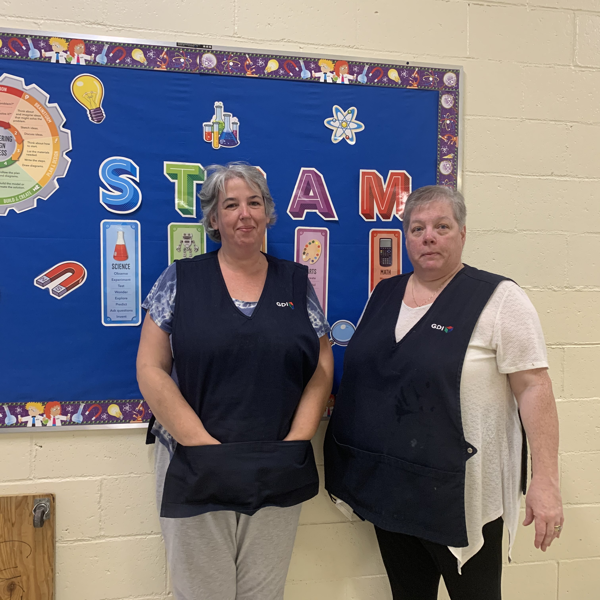
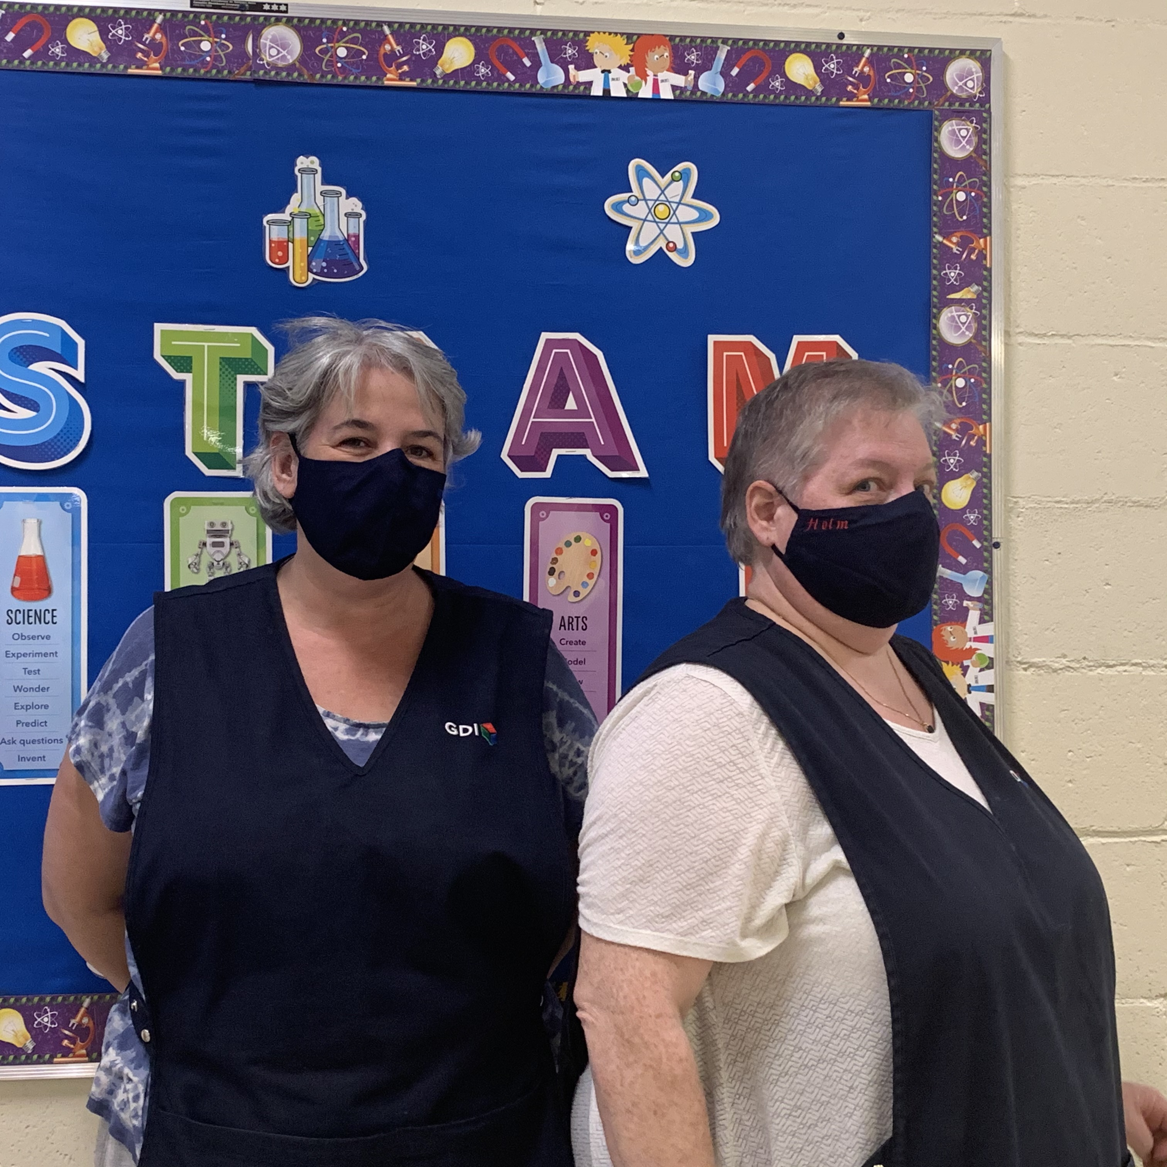
ADMIN. ASSISTANT CUSTODIANS MRS. MYRIE Mrs. Holm/Mrs. Smith

Slide 5
GRADE 3 TEAM
Mrs. Walsh-Graham – Room 139
Mr. Niles – Room 141
Mrs. McWilliams – Room 215
Mme Rowan-Howe (FI)– Room 130

Slide 6
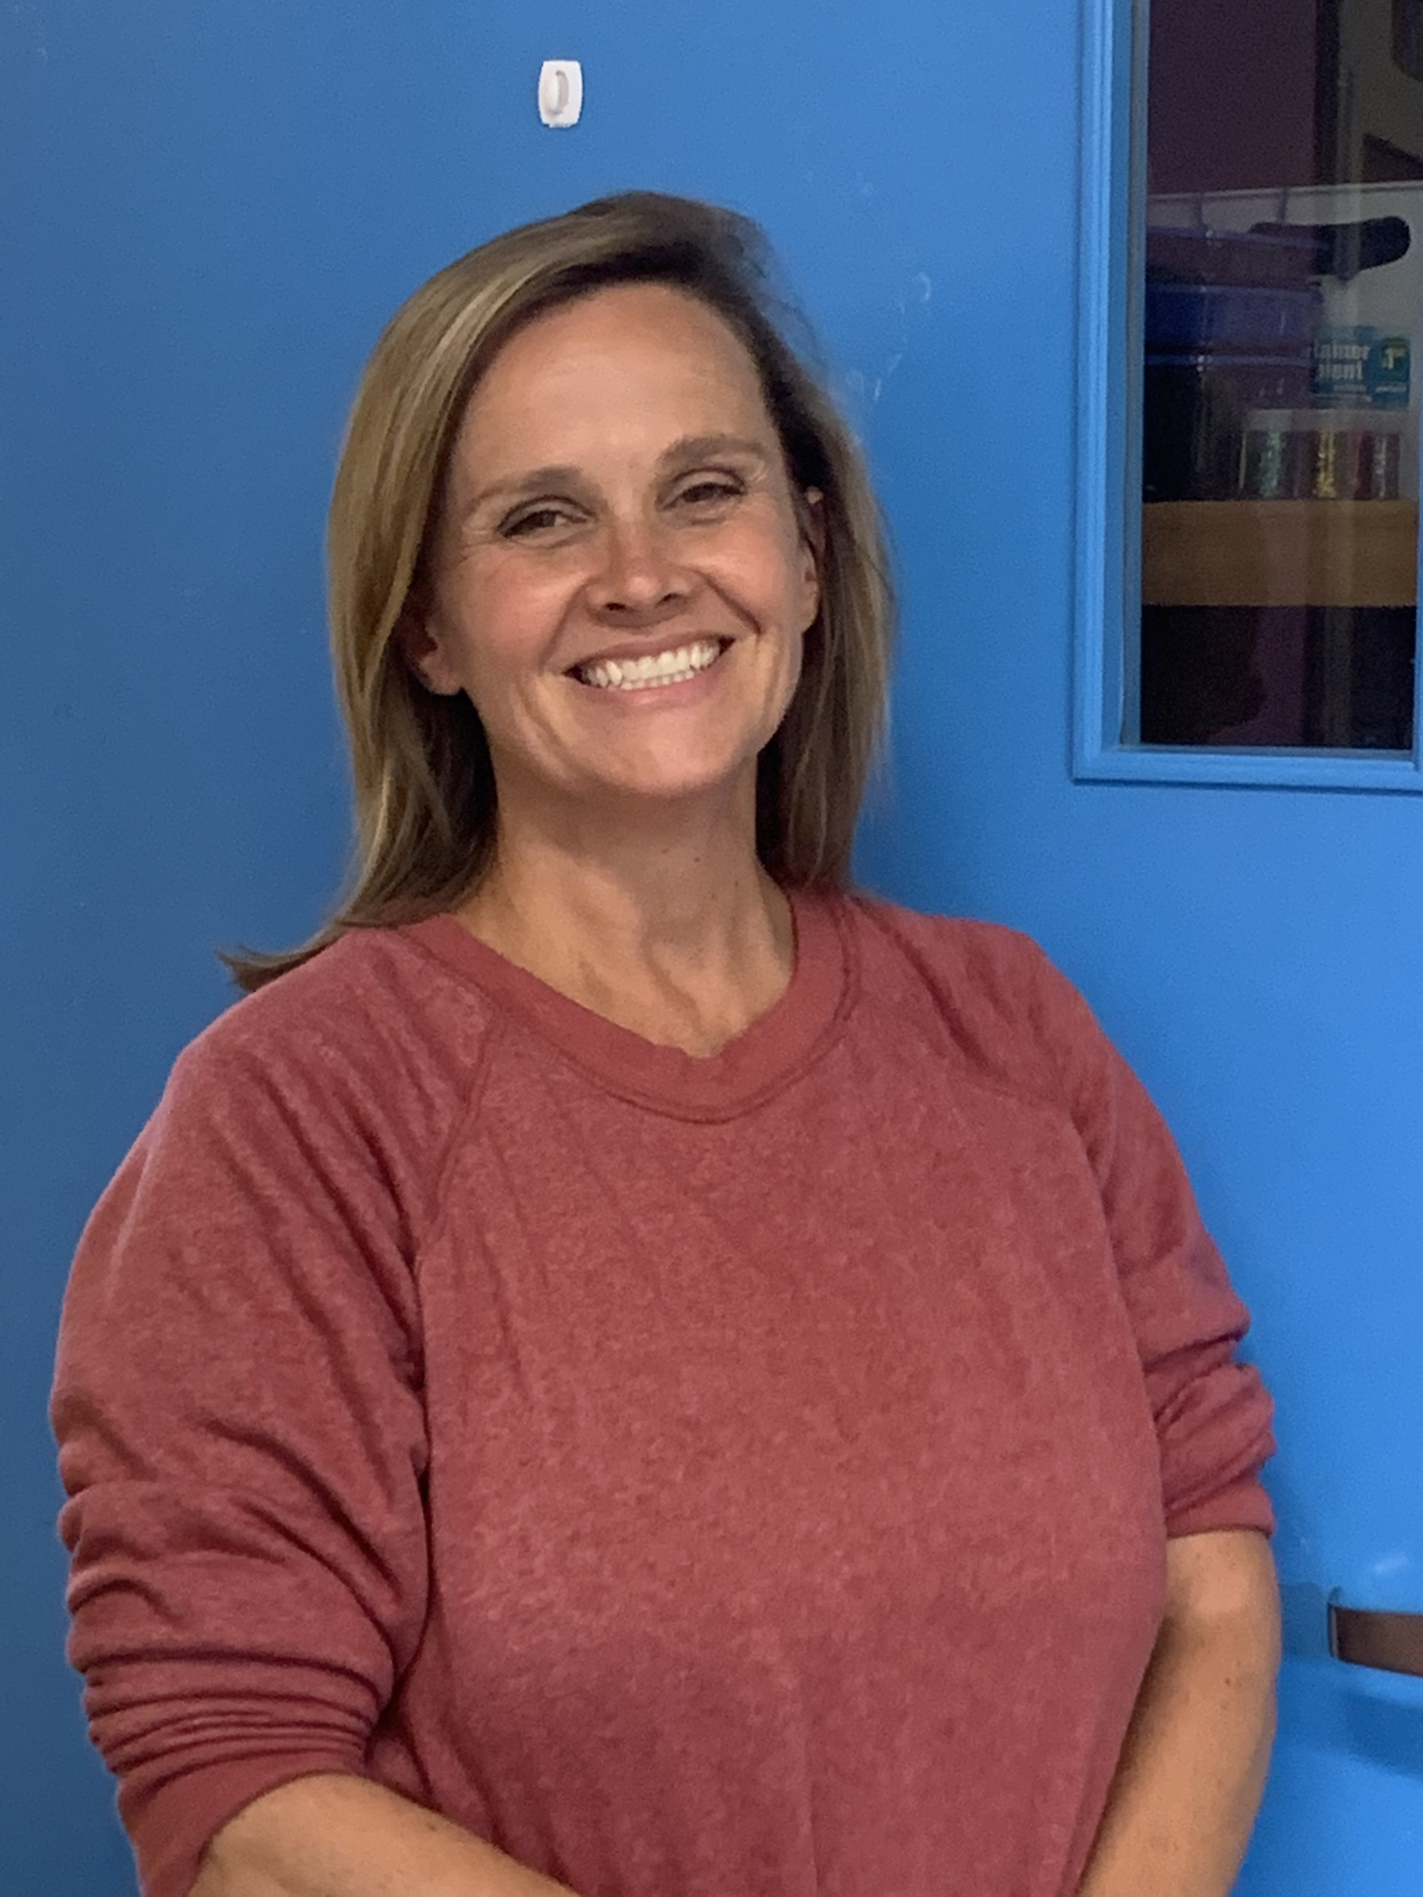
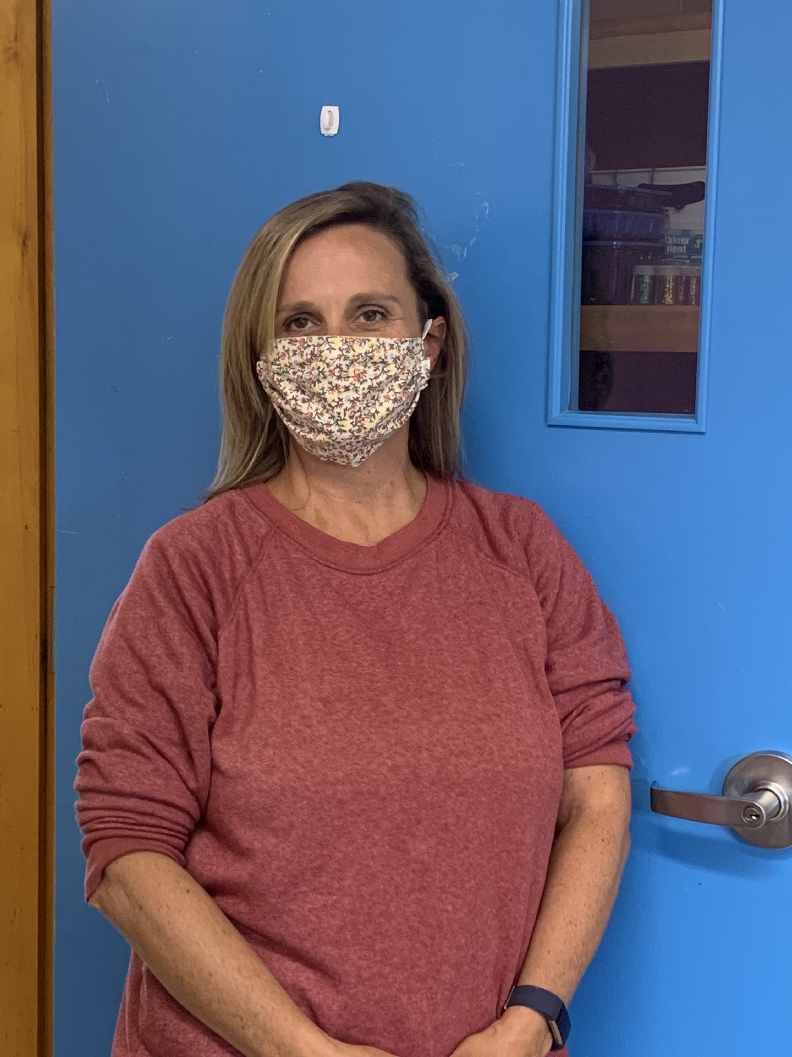
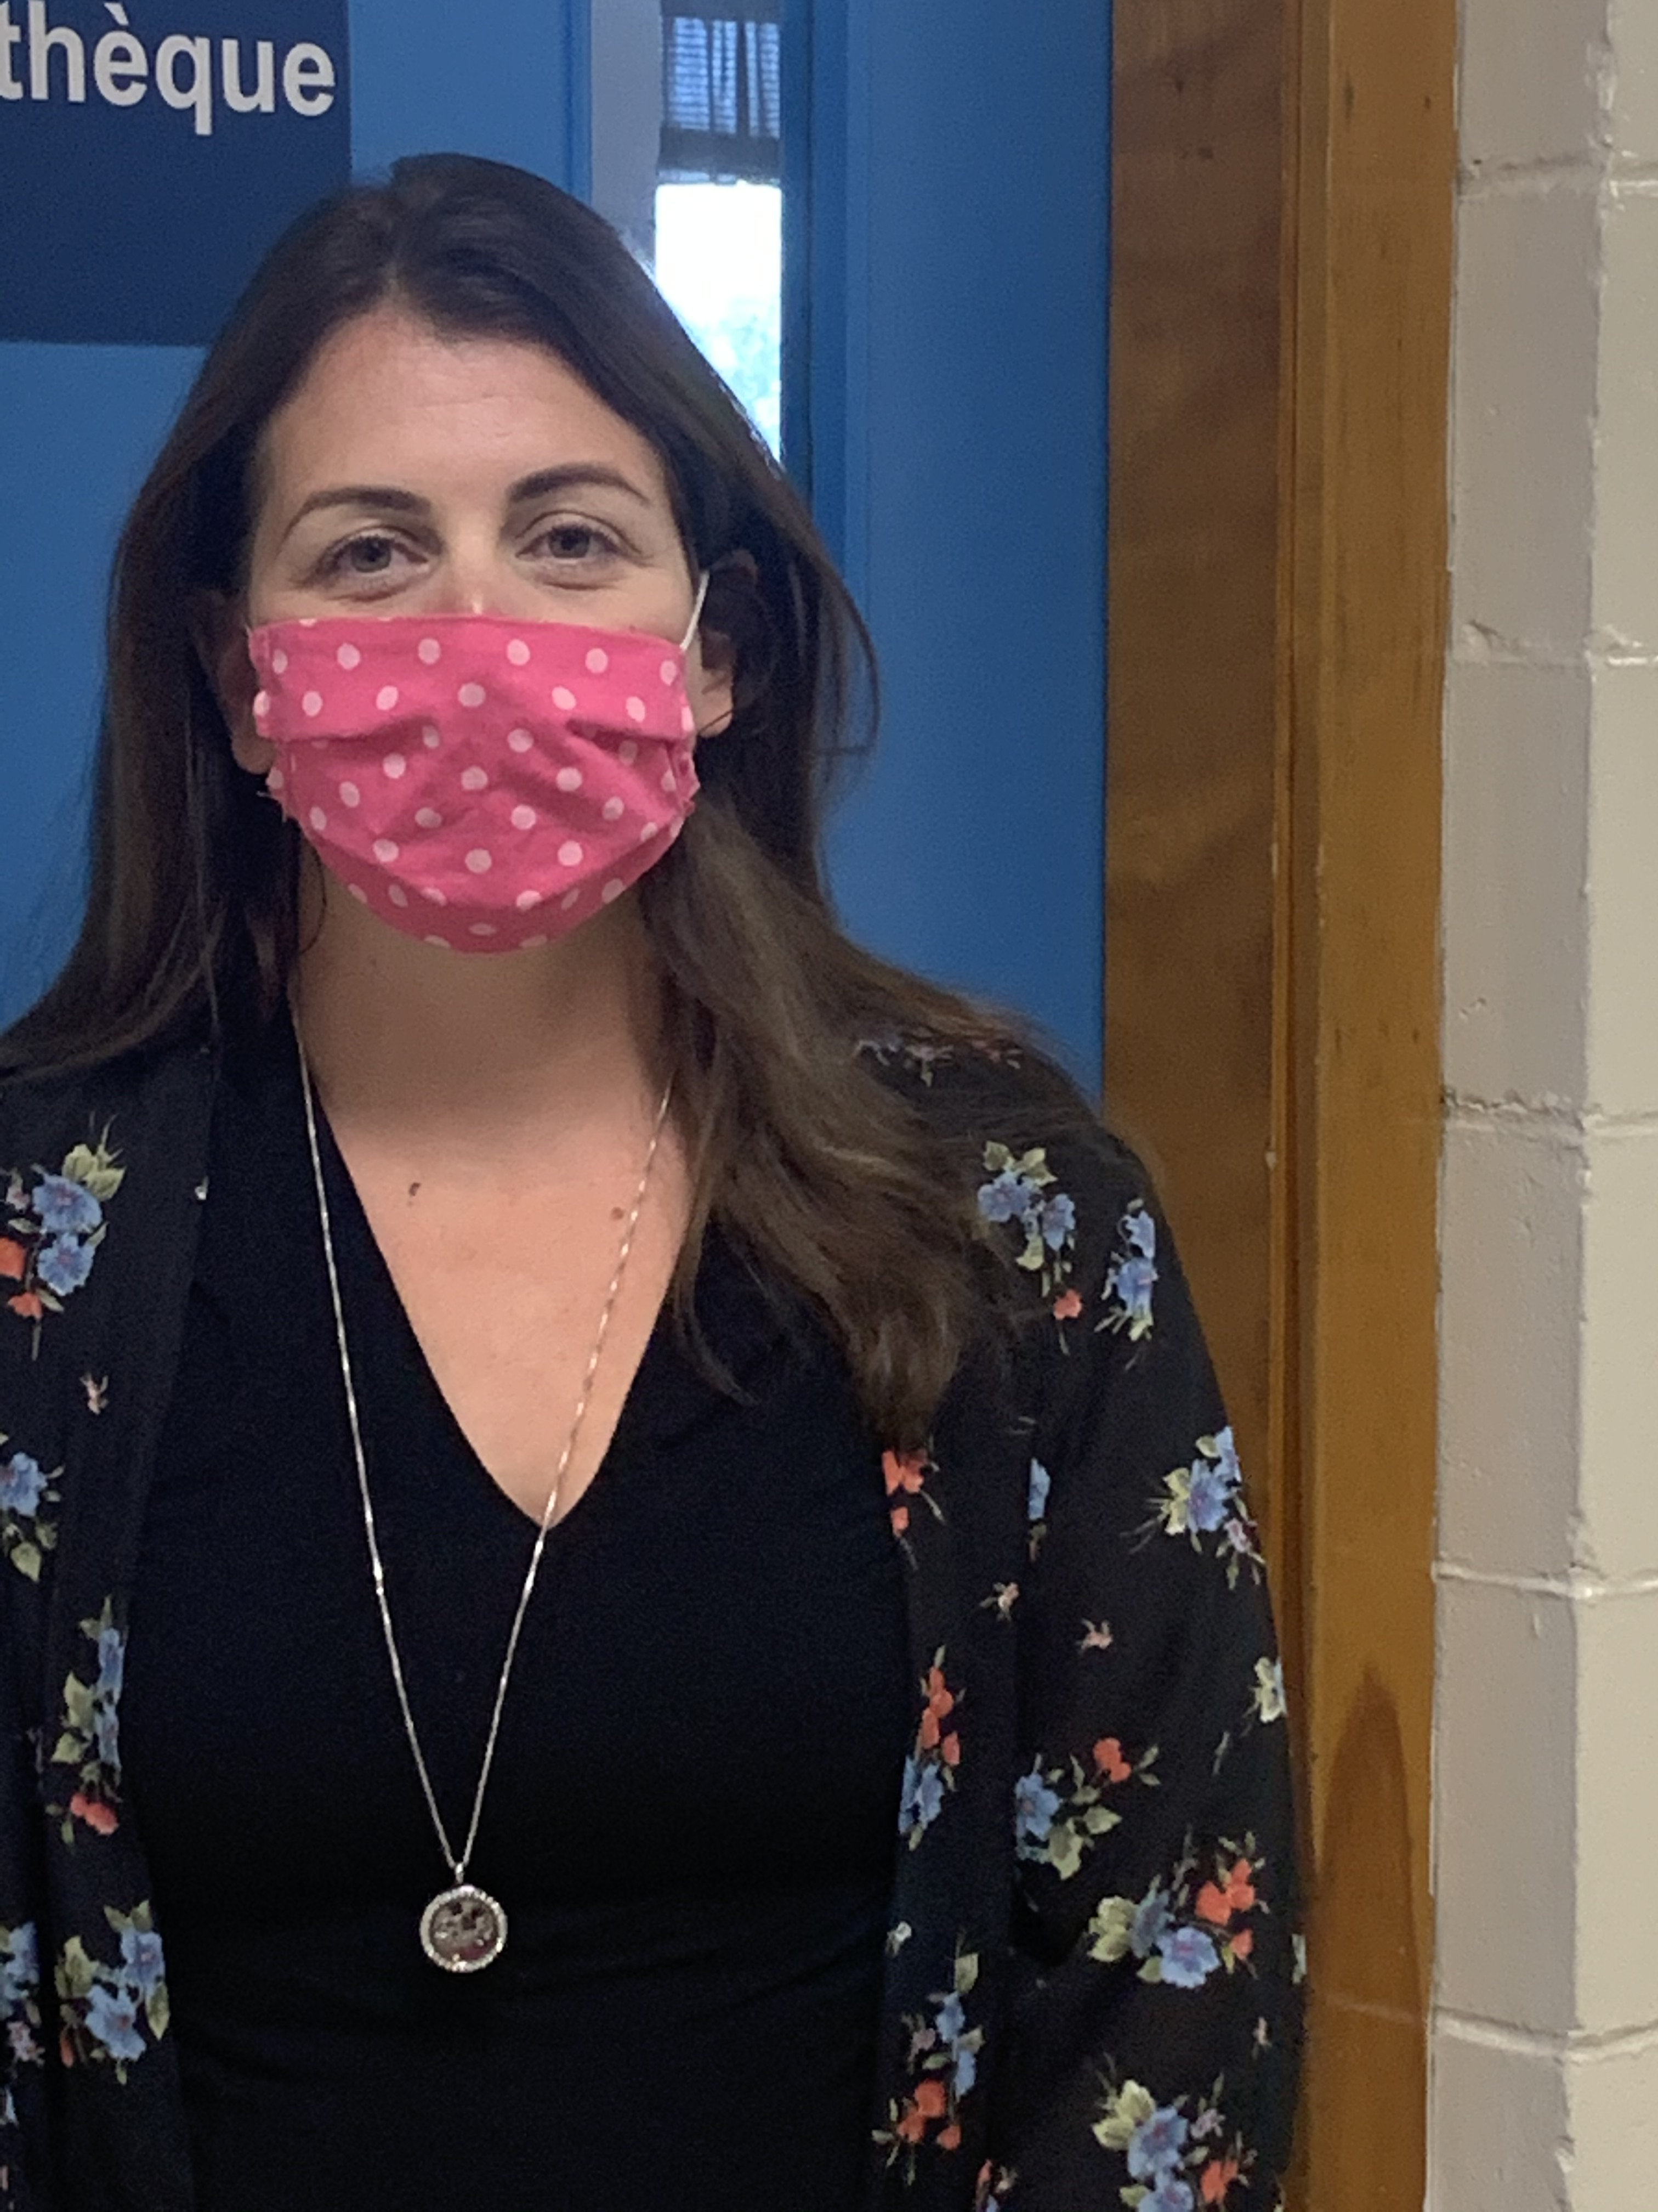
Mrs. Walsh Graham Mrs. McWilliams

Slide 7
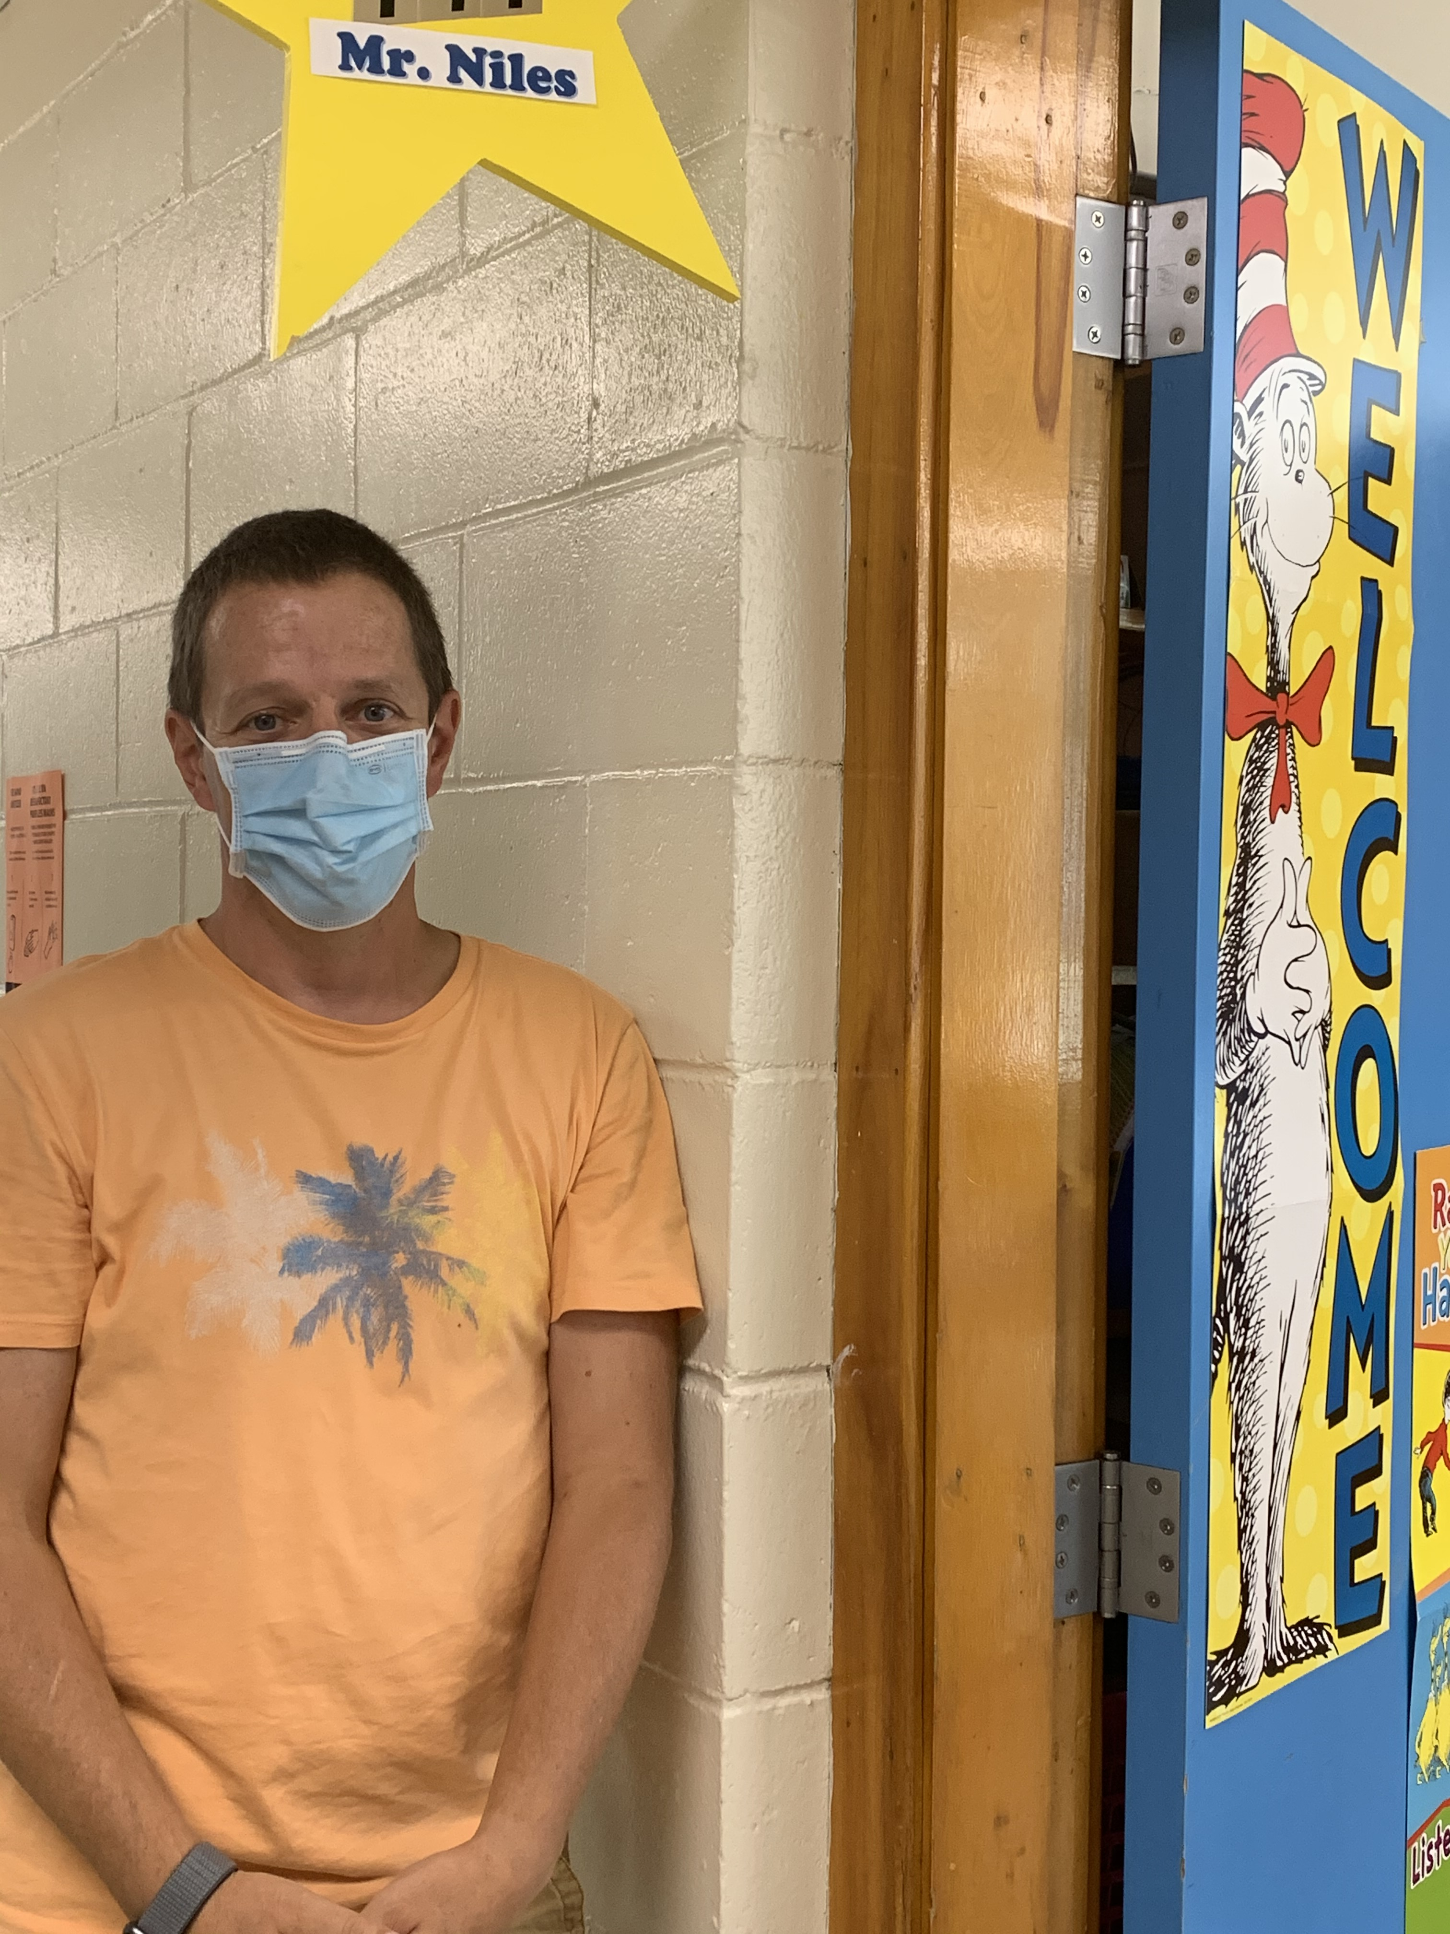
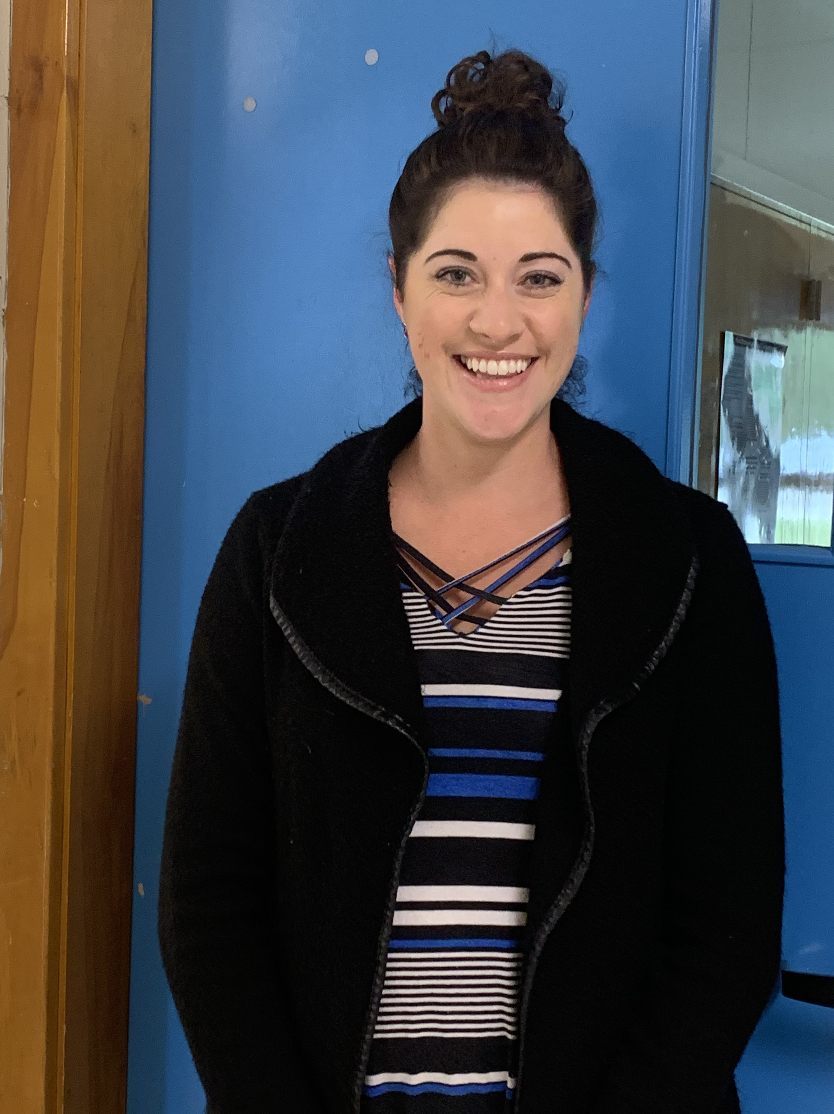
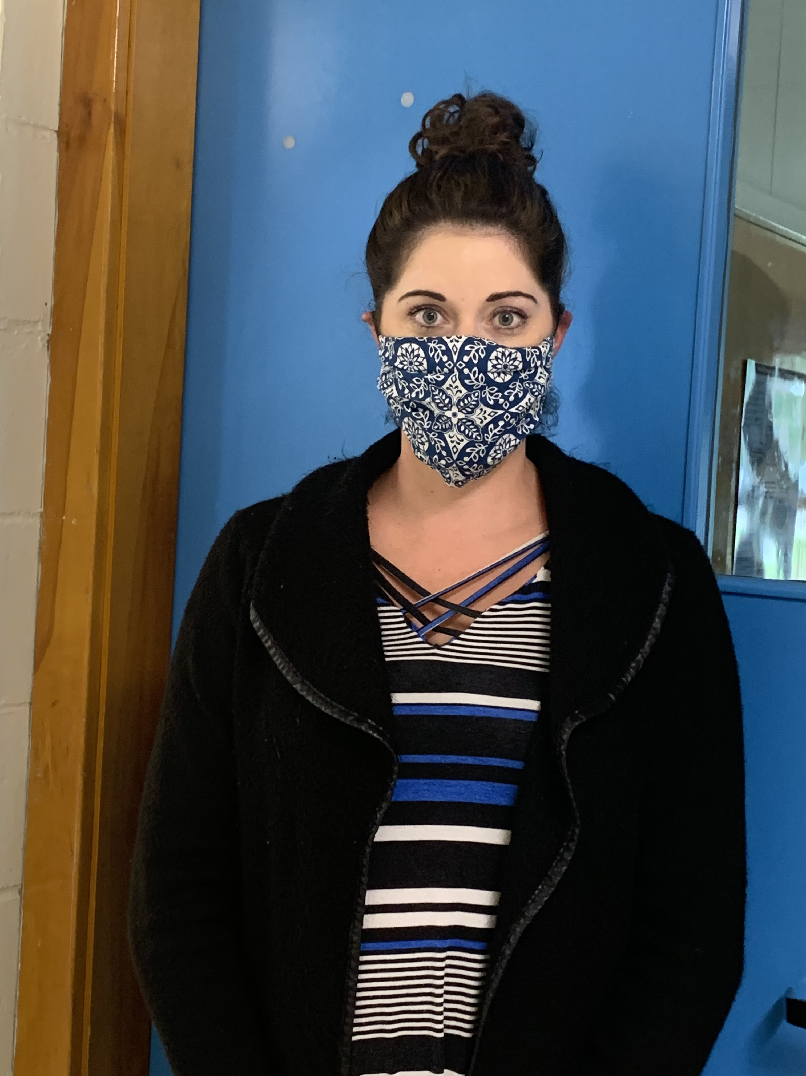
Mr. Niles Mme Rowan-Howe

Slide 8
GRADE 4 TEAM
Ms. Davidson – Room 205
Mrs. Jordan – Room 131
M. Wood (FI)– Room 216
Mme Clerk – Room 139

Slide 9
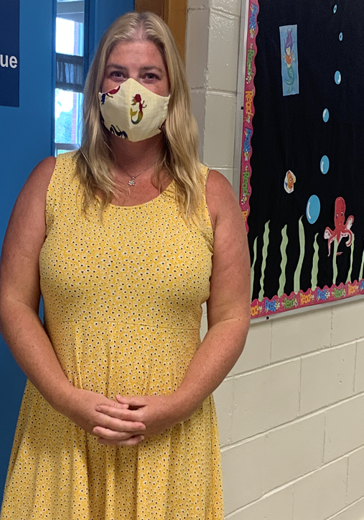
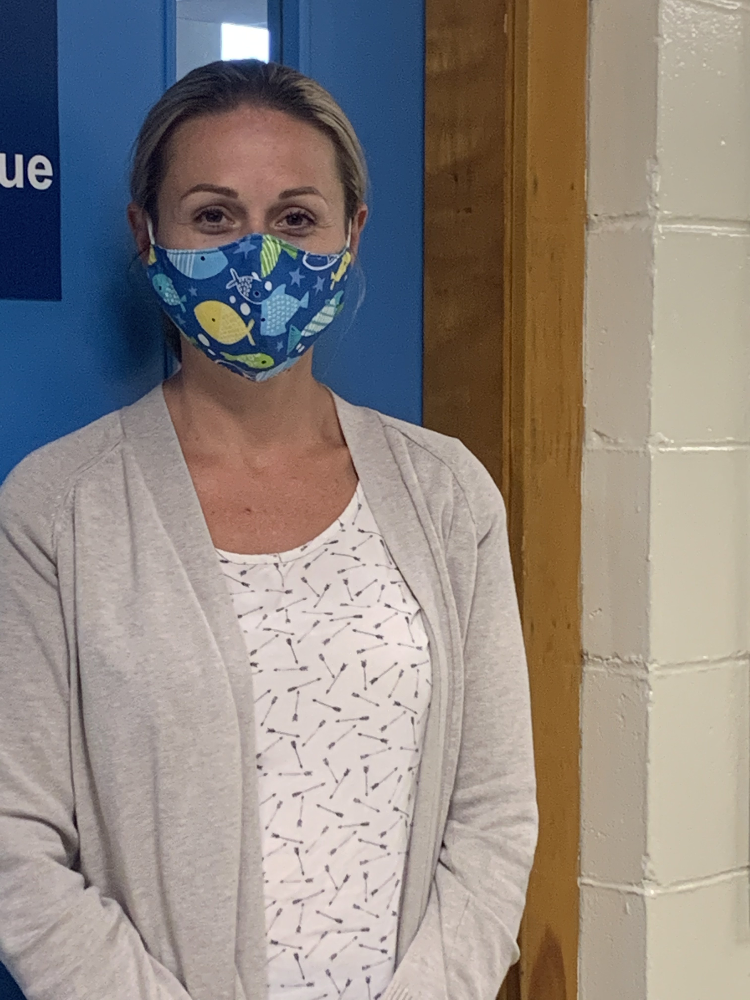
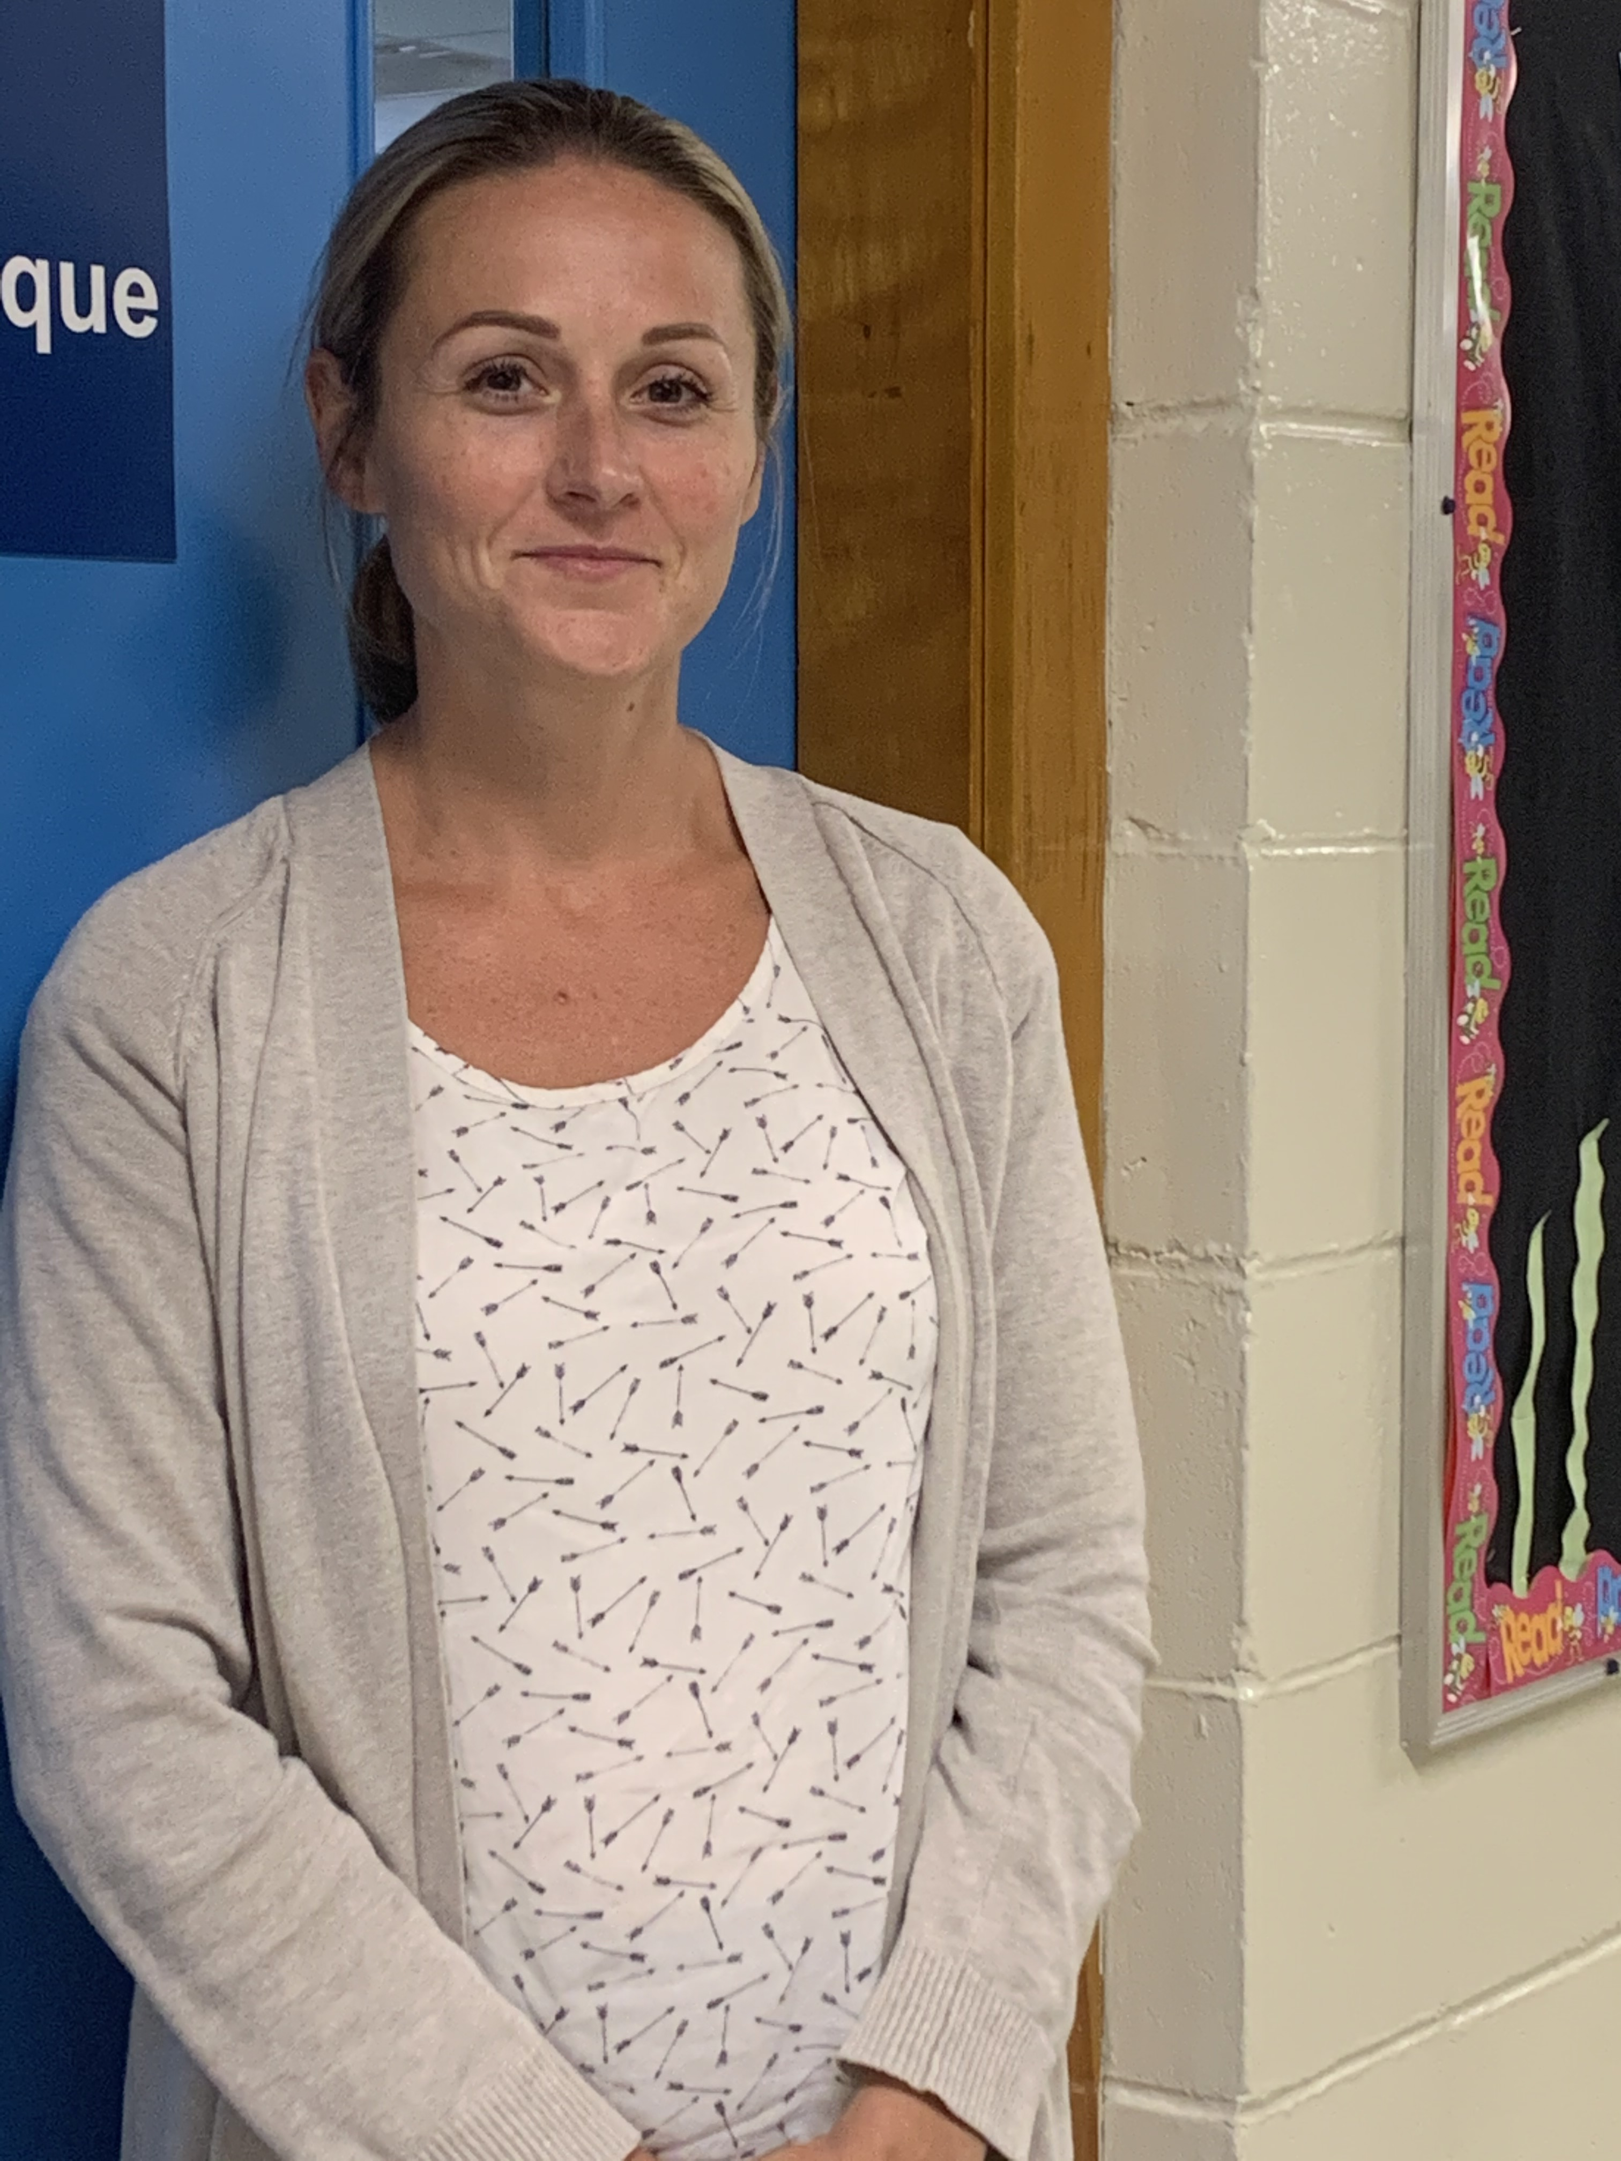
Mme Clerk Mrs. Jordan (VP)

Slide 10
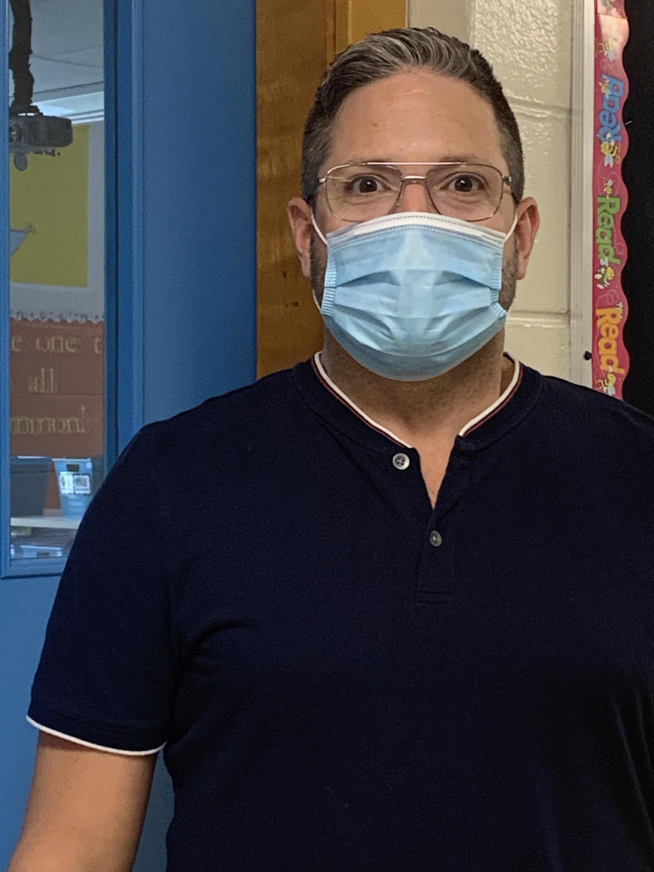
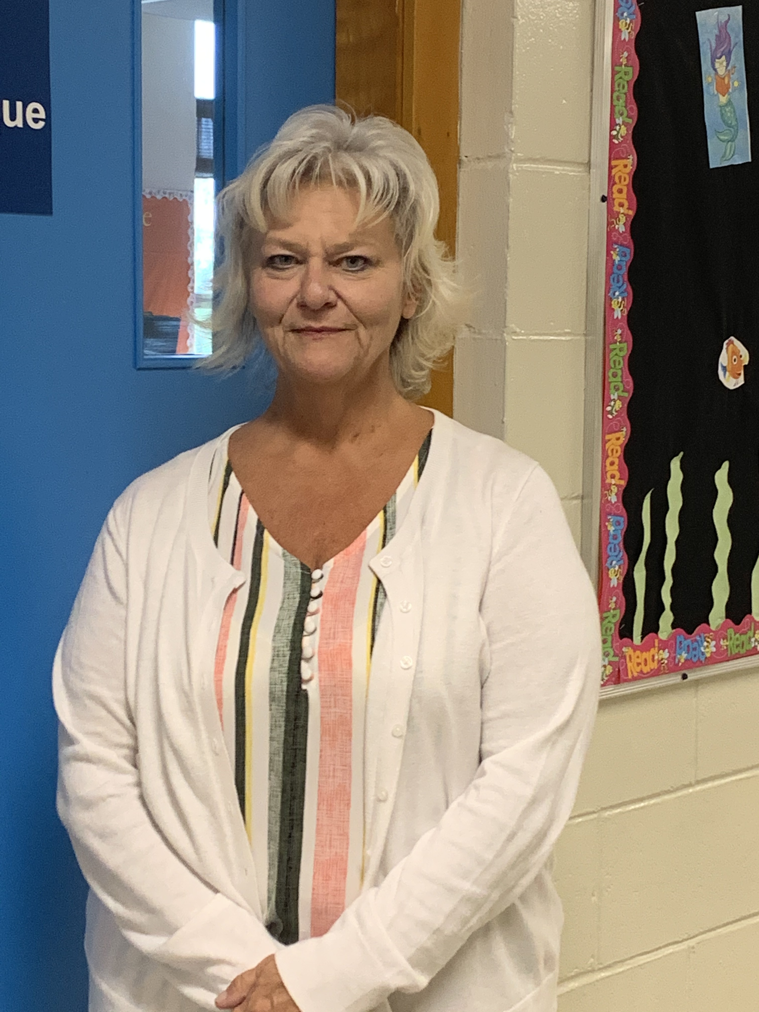
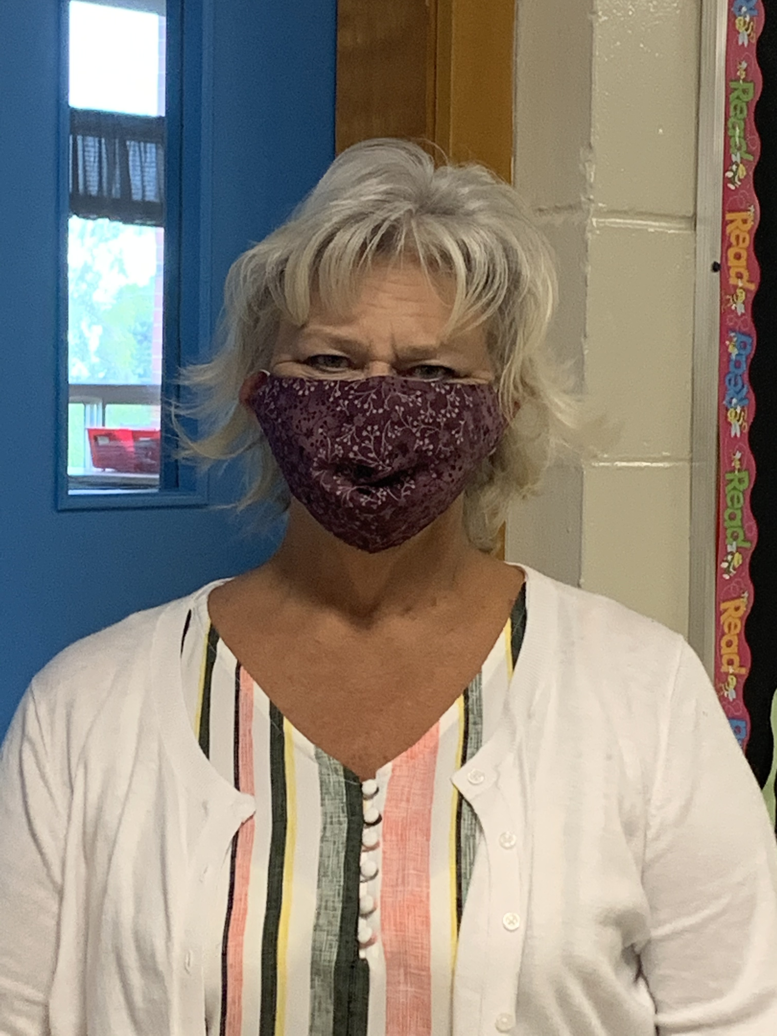
M Wood Mrs. Davidson

Slide 11
GRADE 5 TEAM
Mrs. Small – Room 206
Mrs. Morris – Room 209
Mme Drillen (FI) – Room 210
Mme Lavoie (FI) – Room 217
Ms. Morgan – Room 218

Slide 12
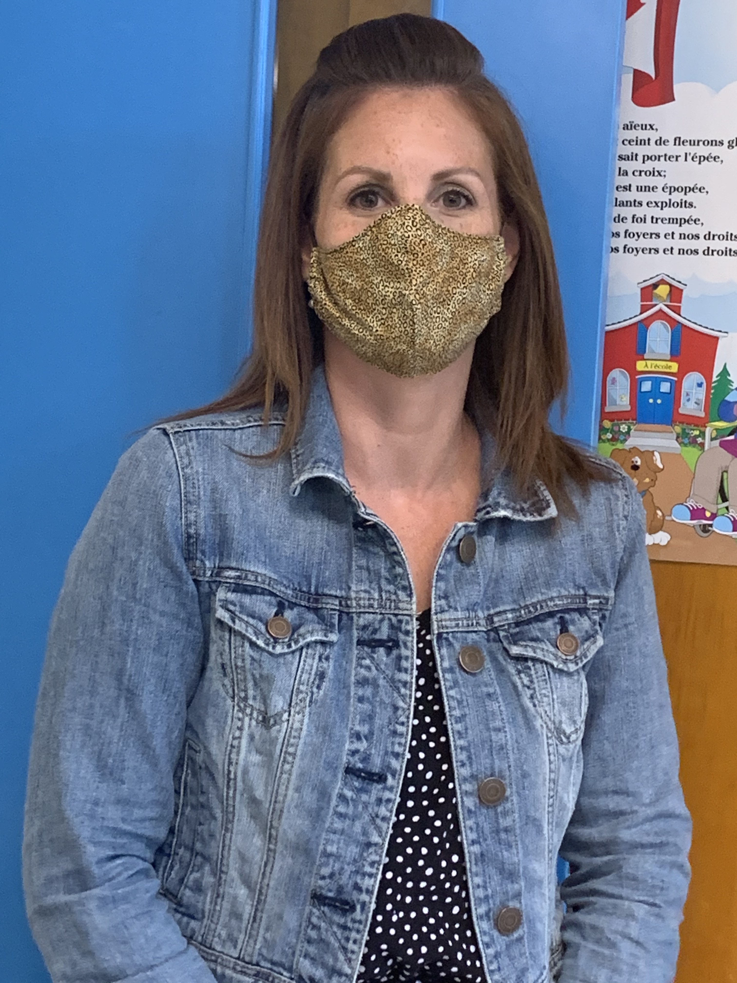
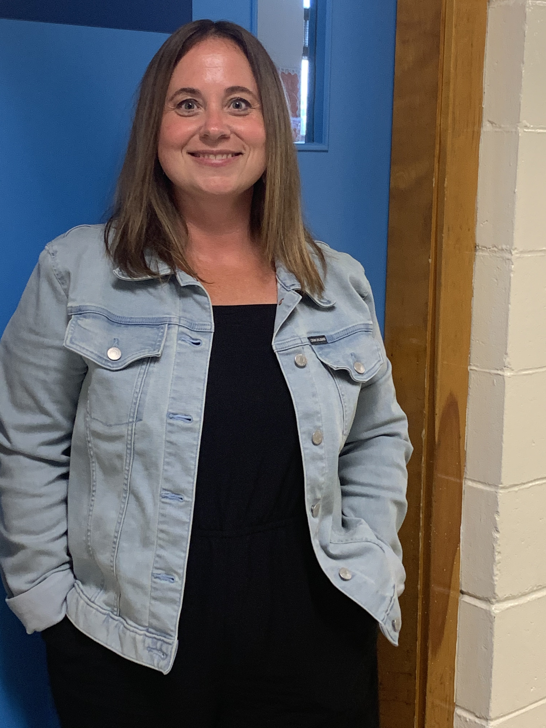
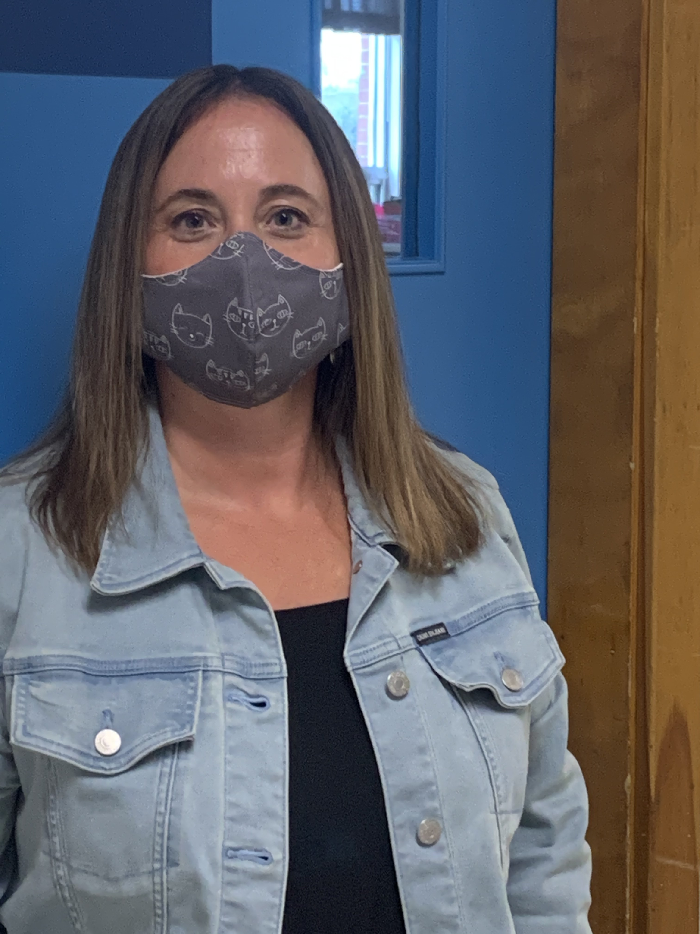
Mrs. Morris Ms. Morgan

Slide 13
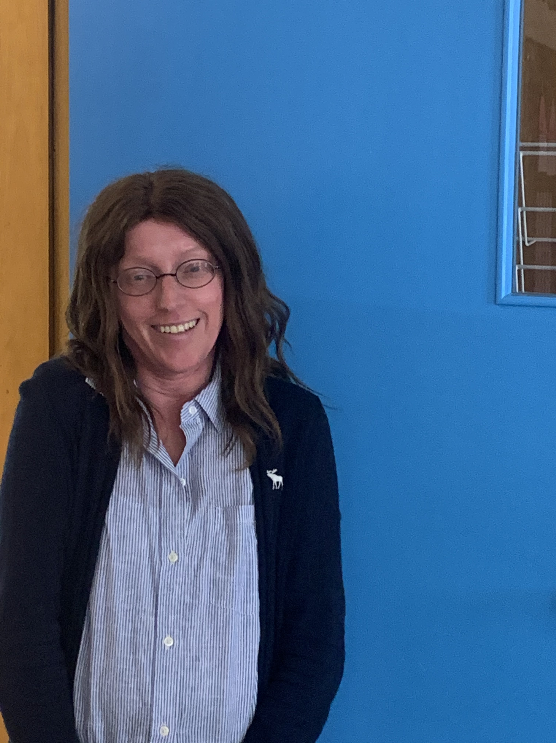
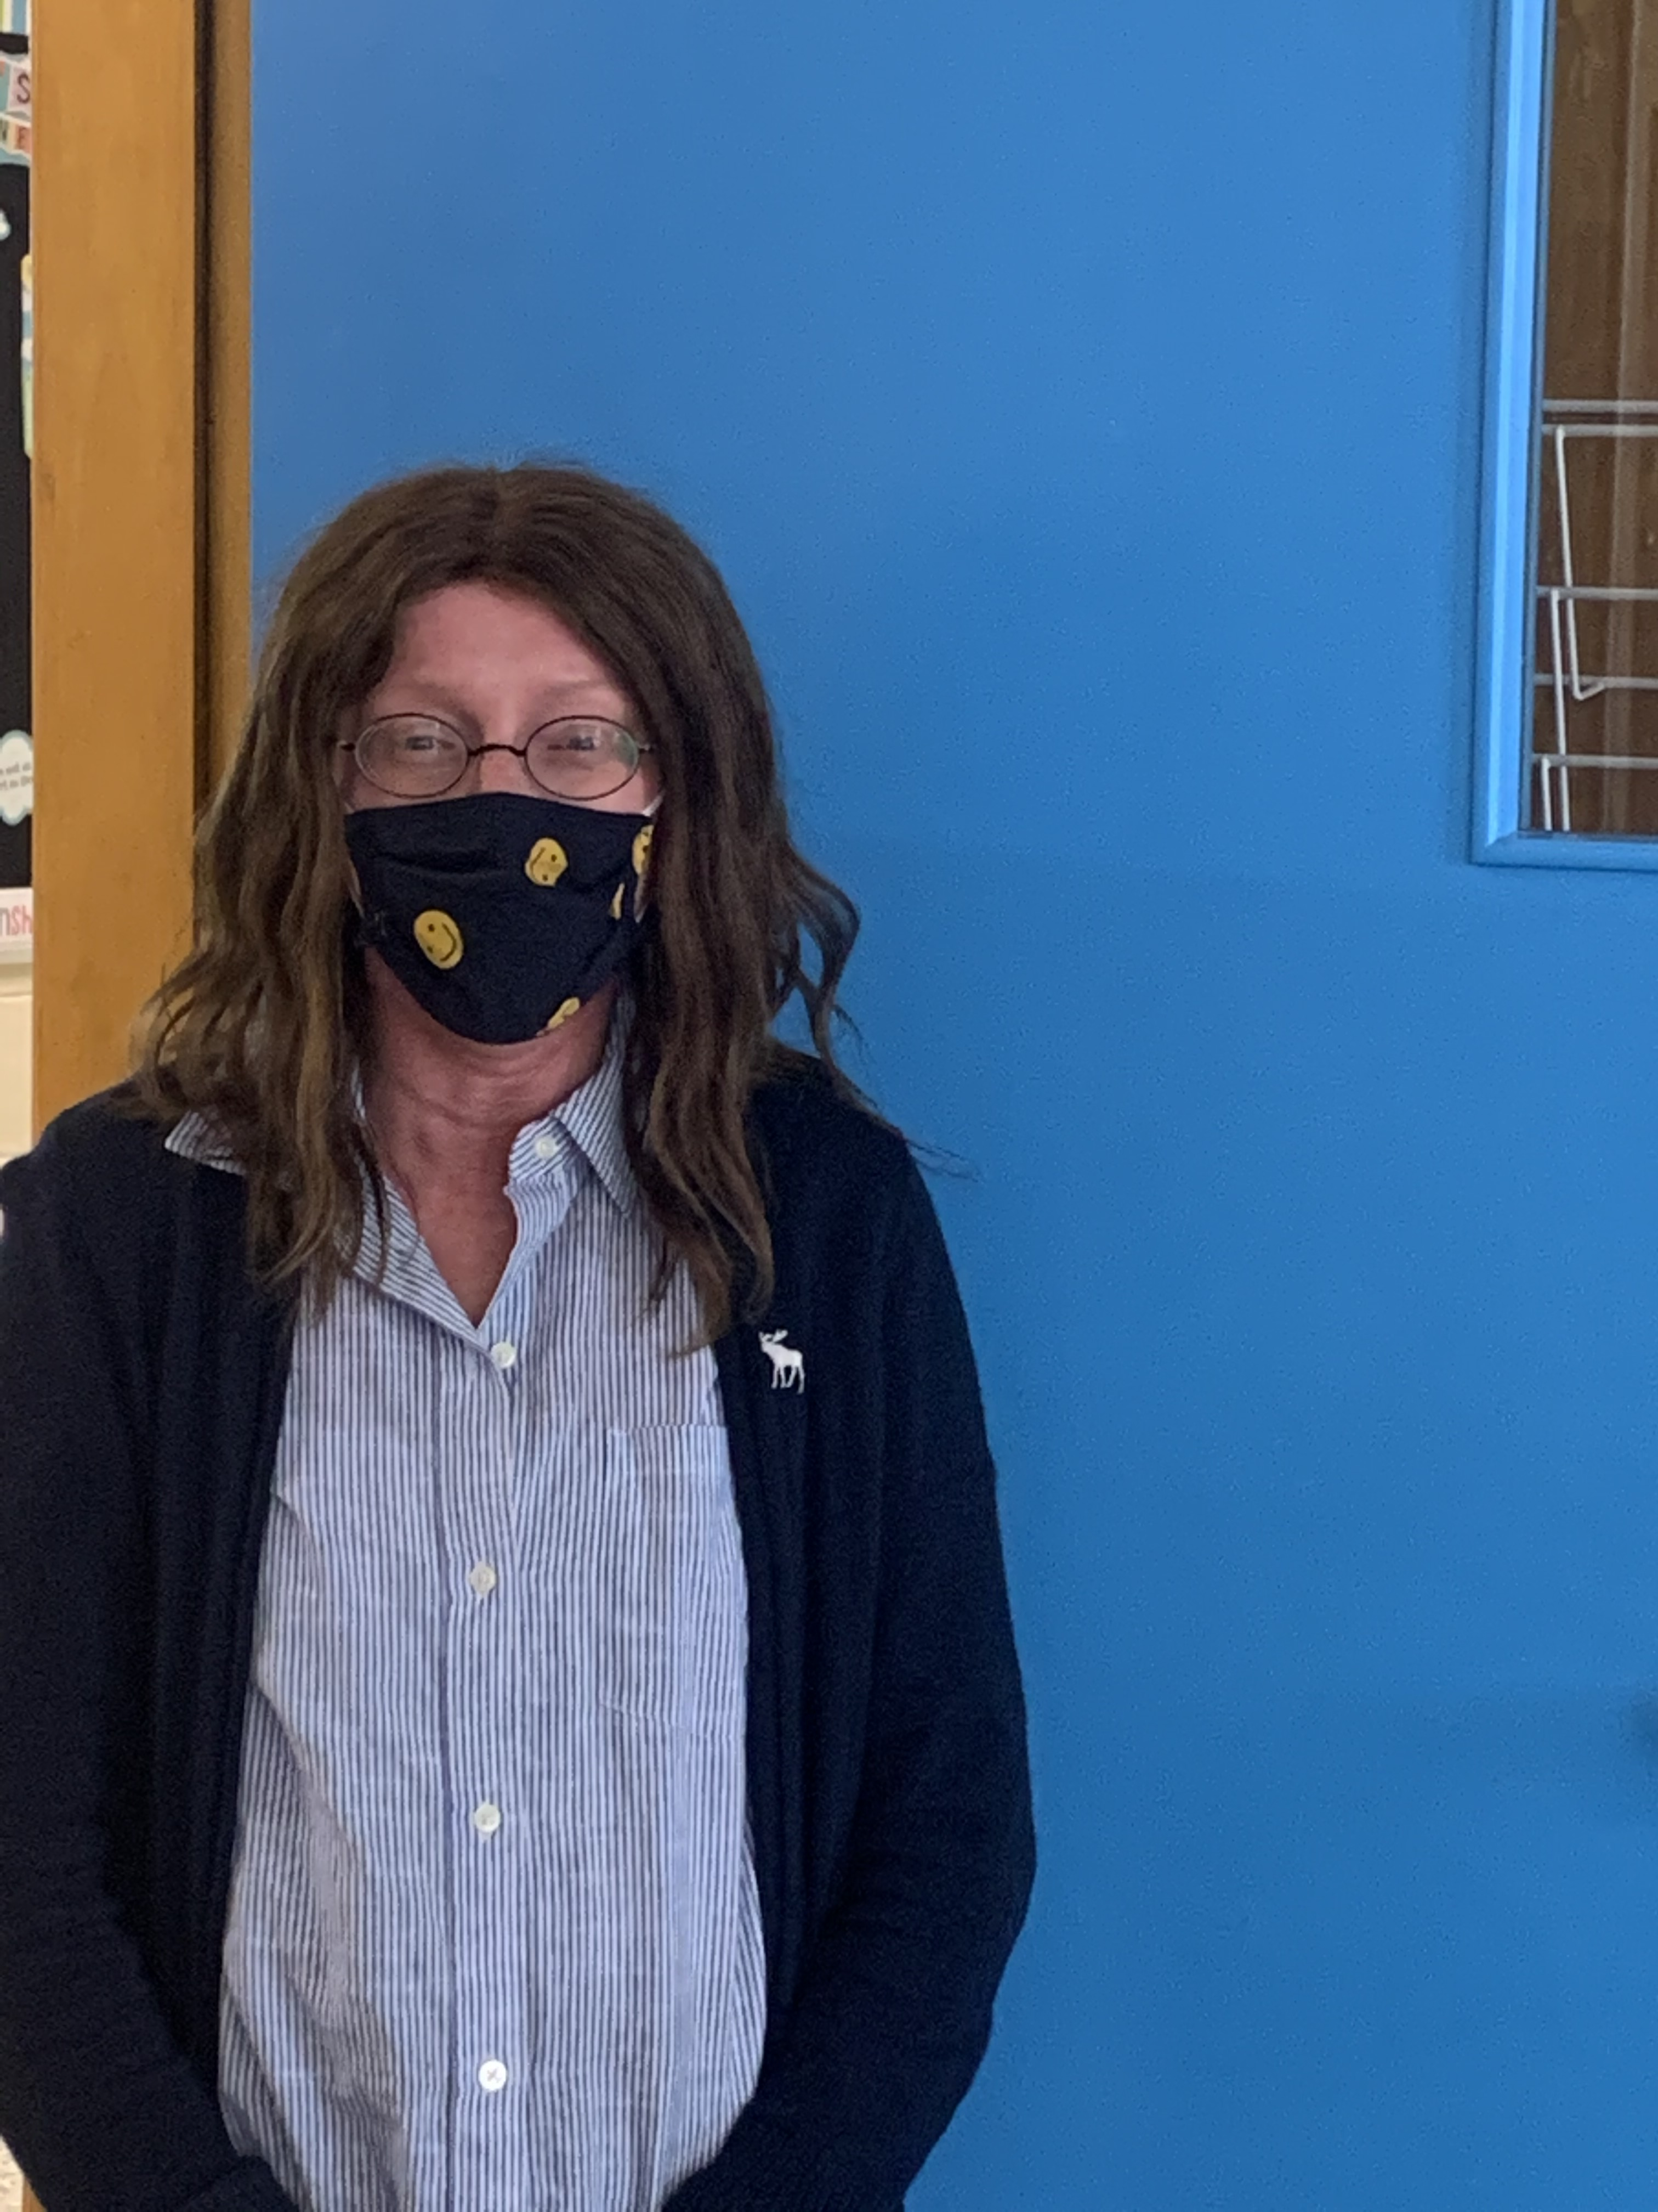
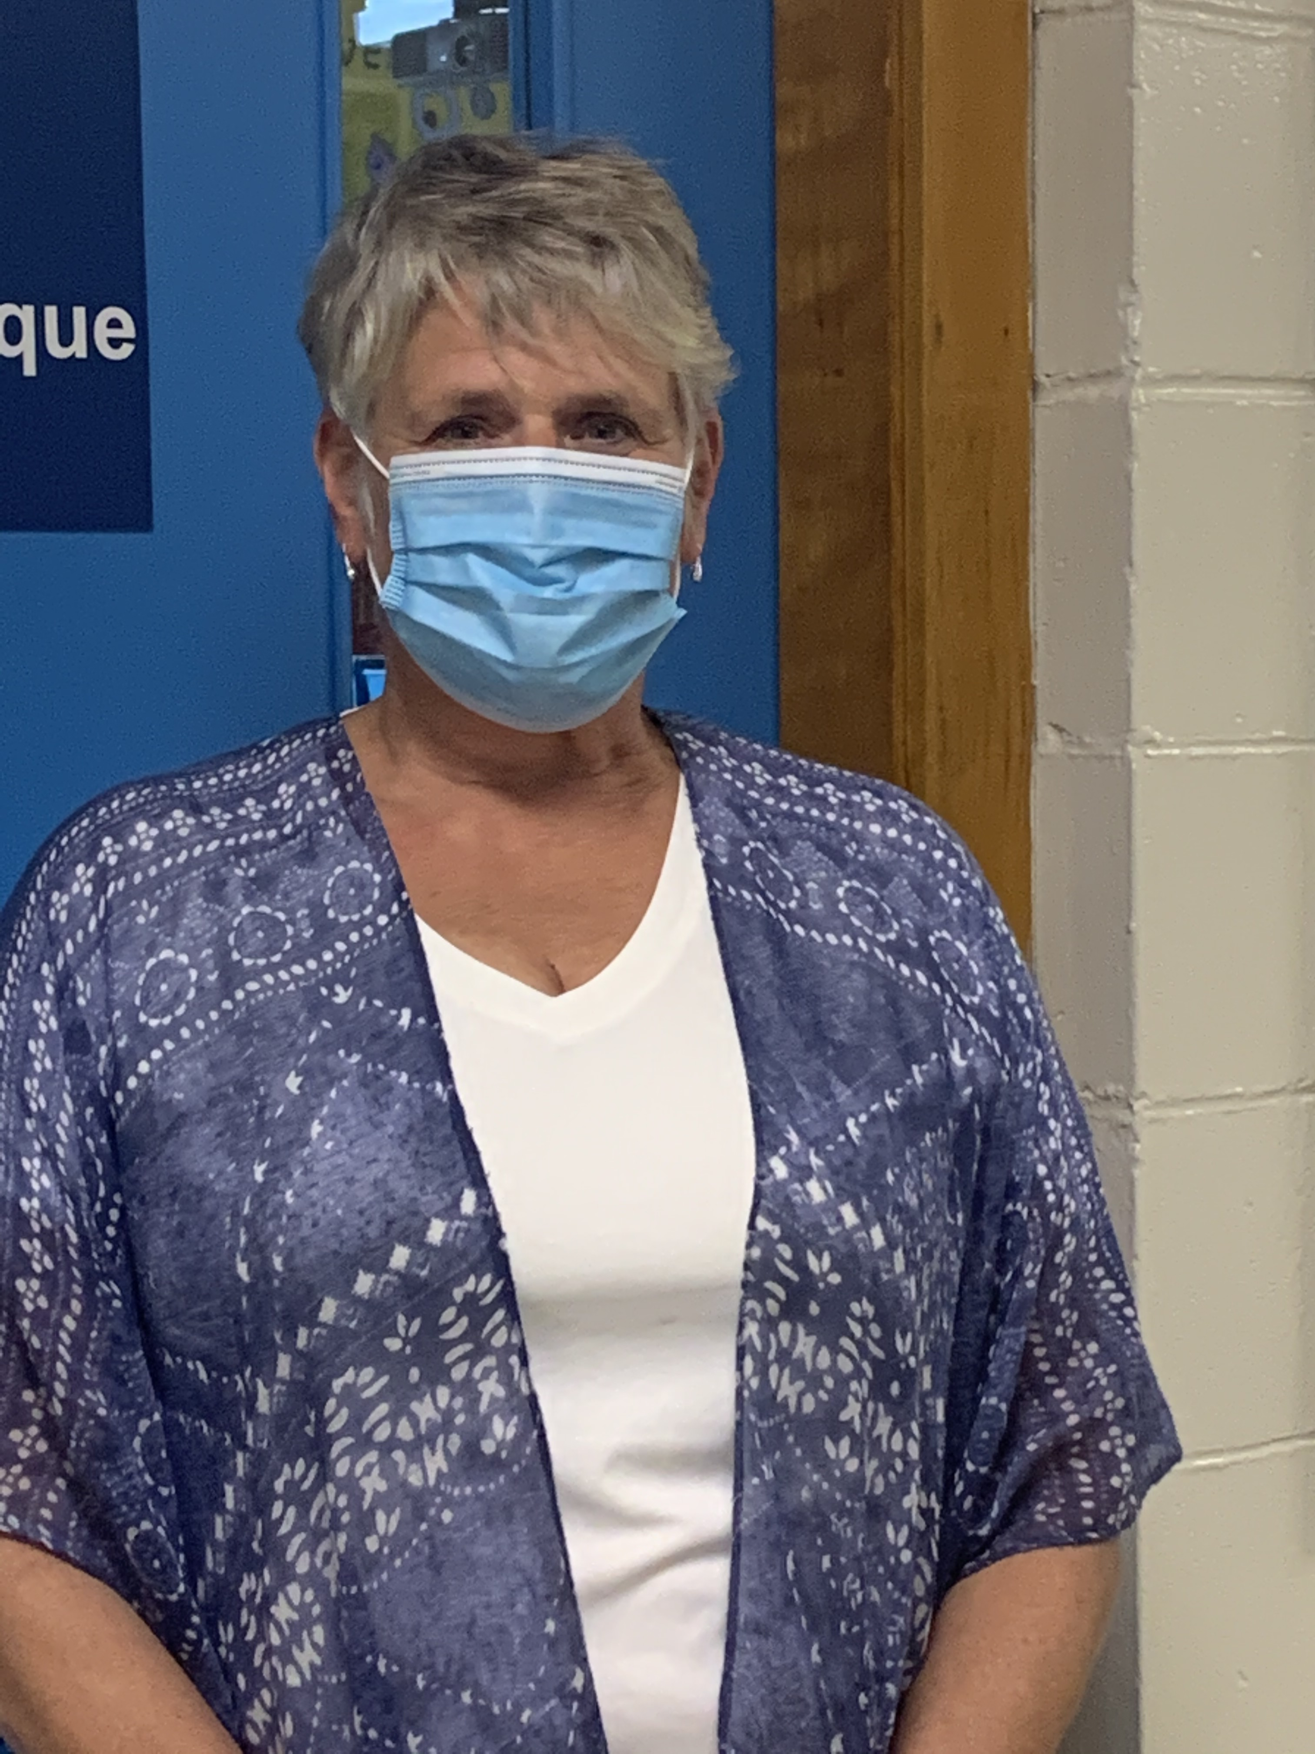
Mrs. Small Mme Lavoie

Slide 14
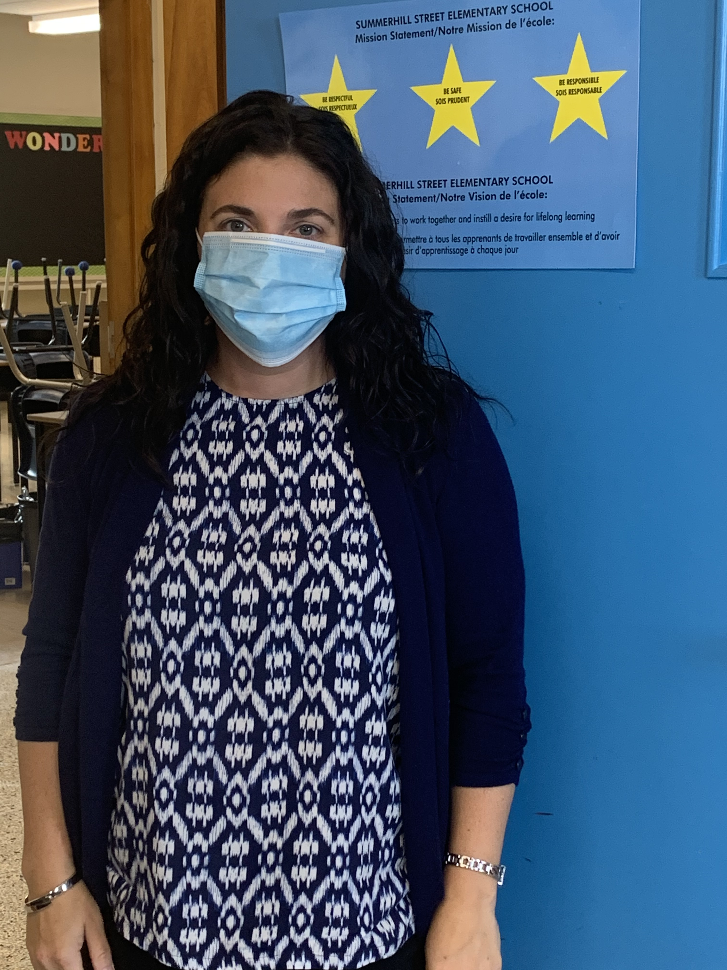
Mme Drillen

Slide 15
Other members of our team:
Mrs. Keizer (Physical Education)
Mr. Makhot (Music)
Mrs. Keirstead (Resource)
Mrs. Voutour – Barton (Guidance)

Slide 16
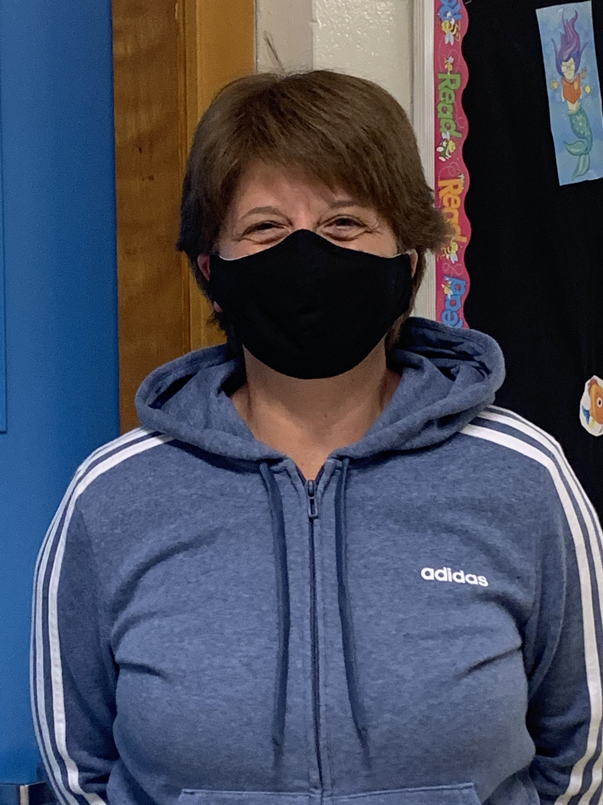
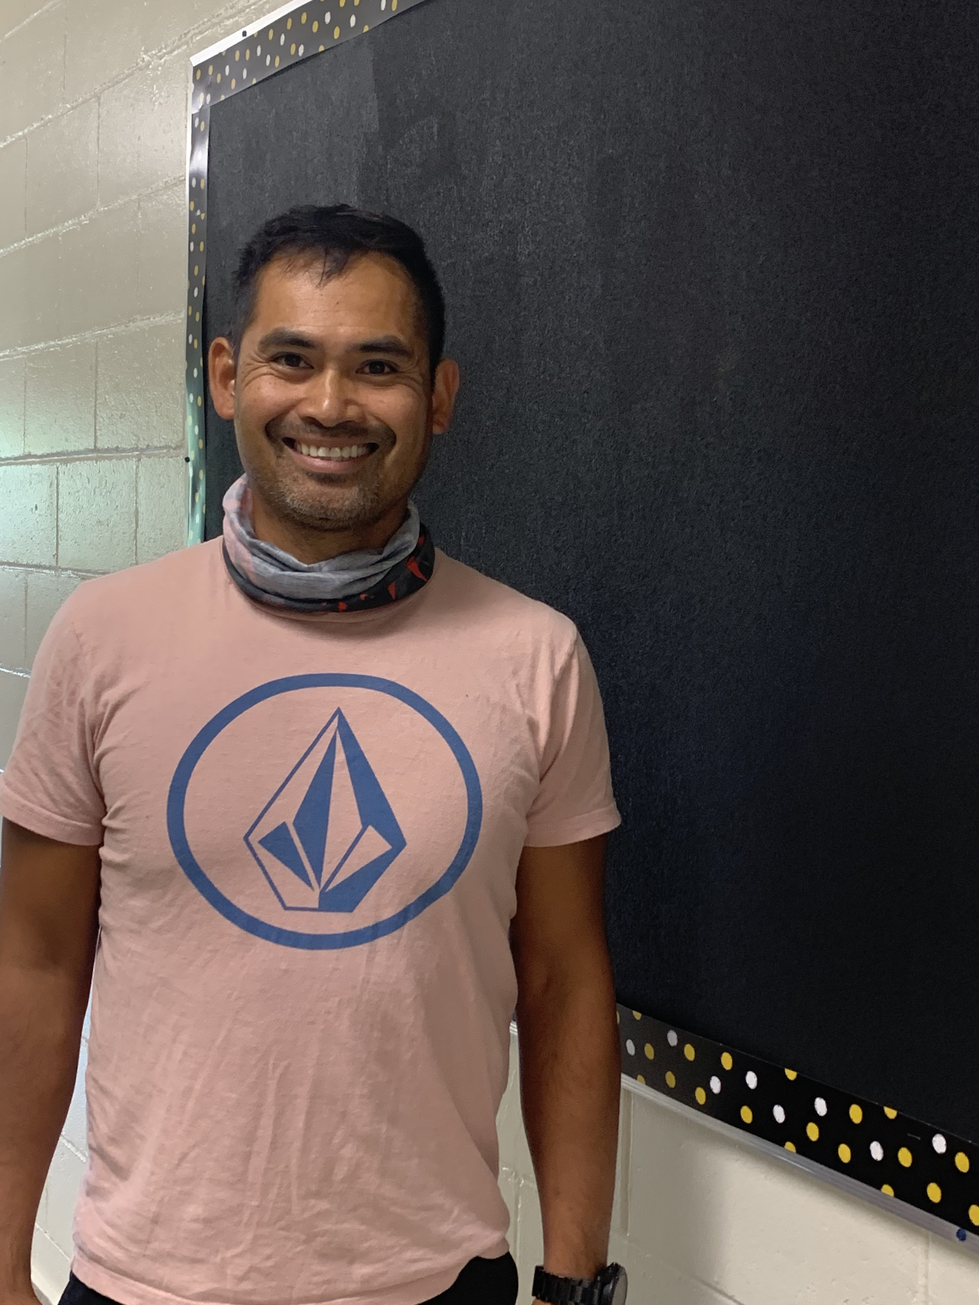
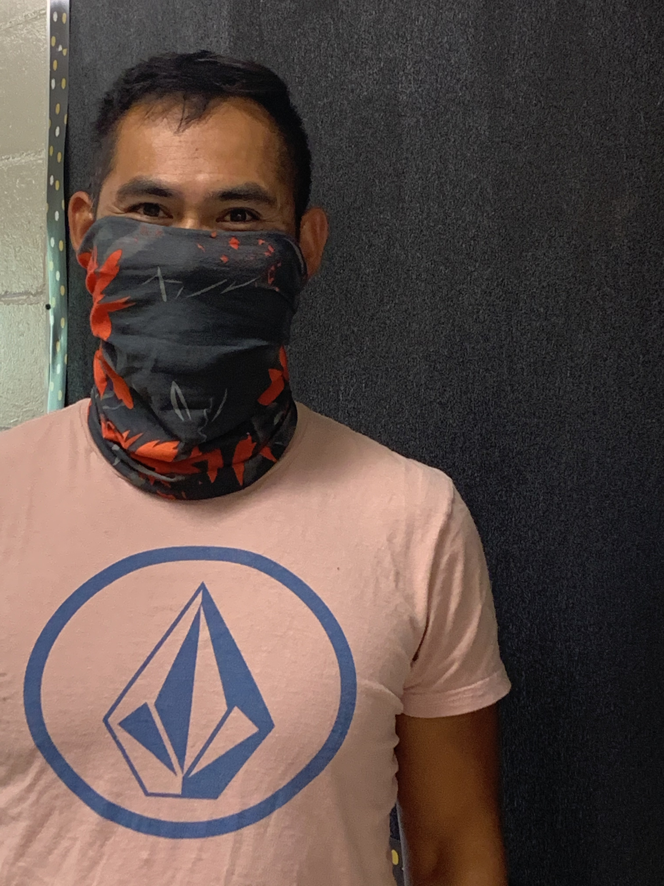
Mrs. Keizer (Phys. Ed.) Mr. Makhot (Music)

Slide 17
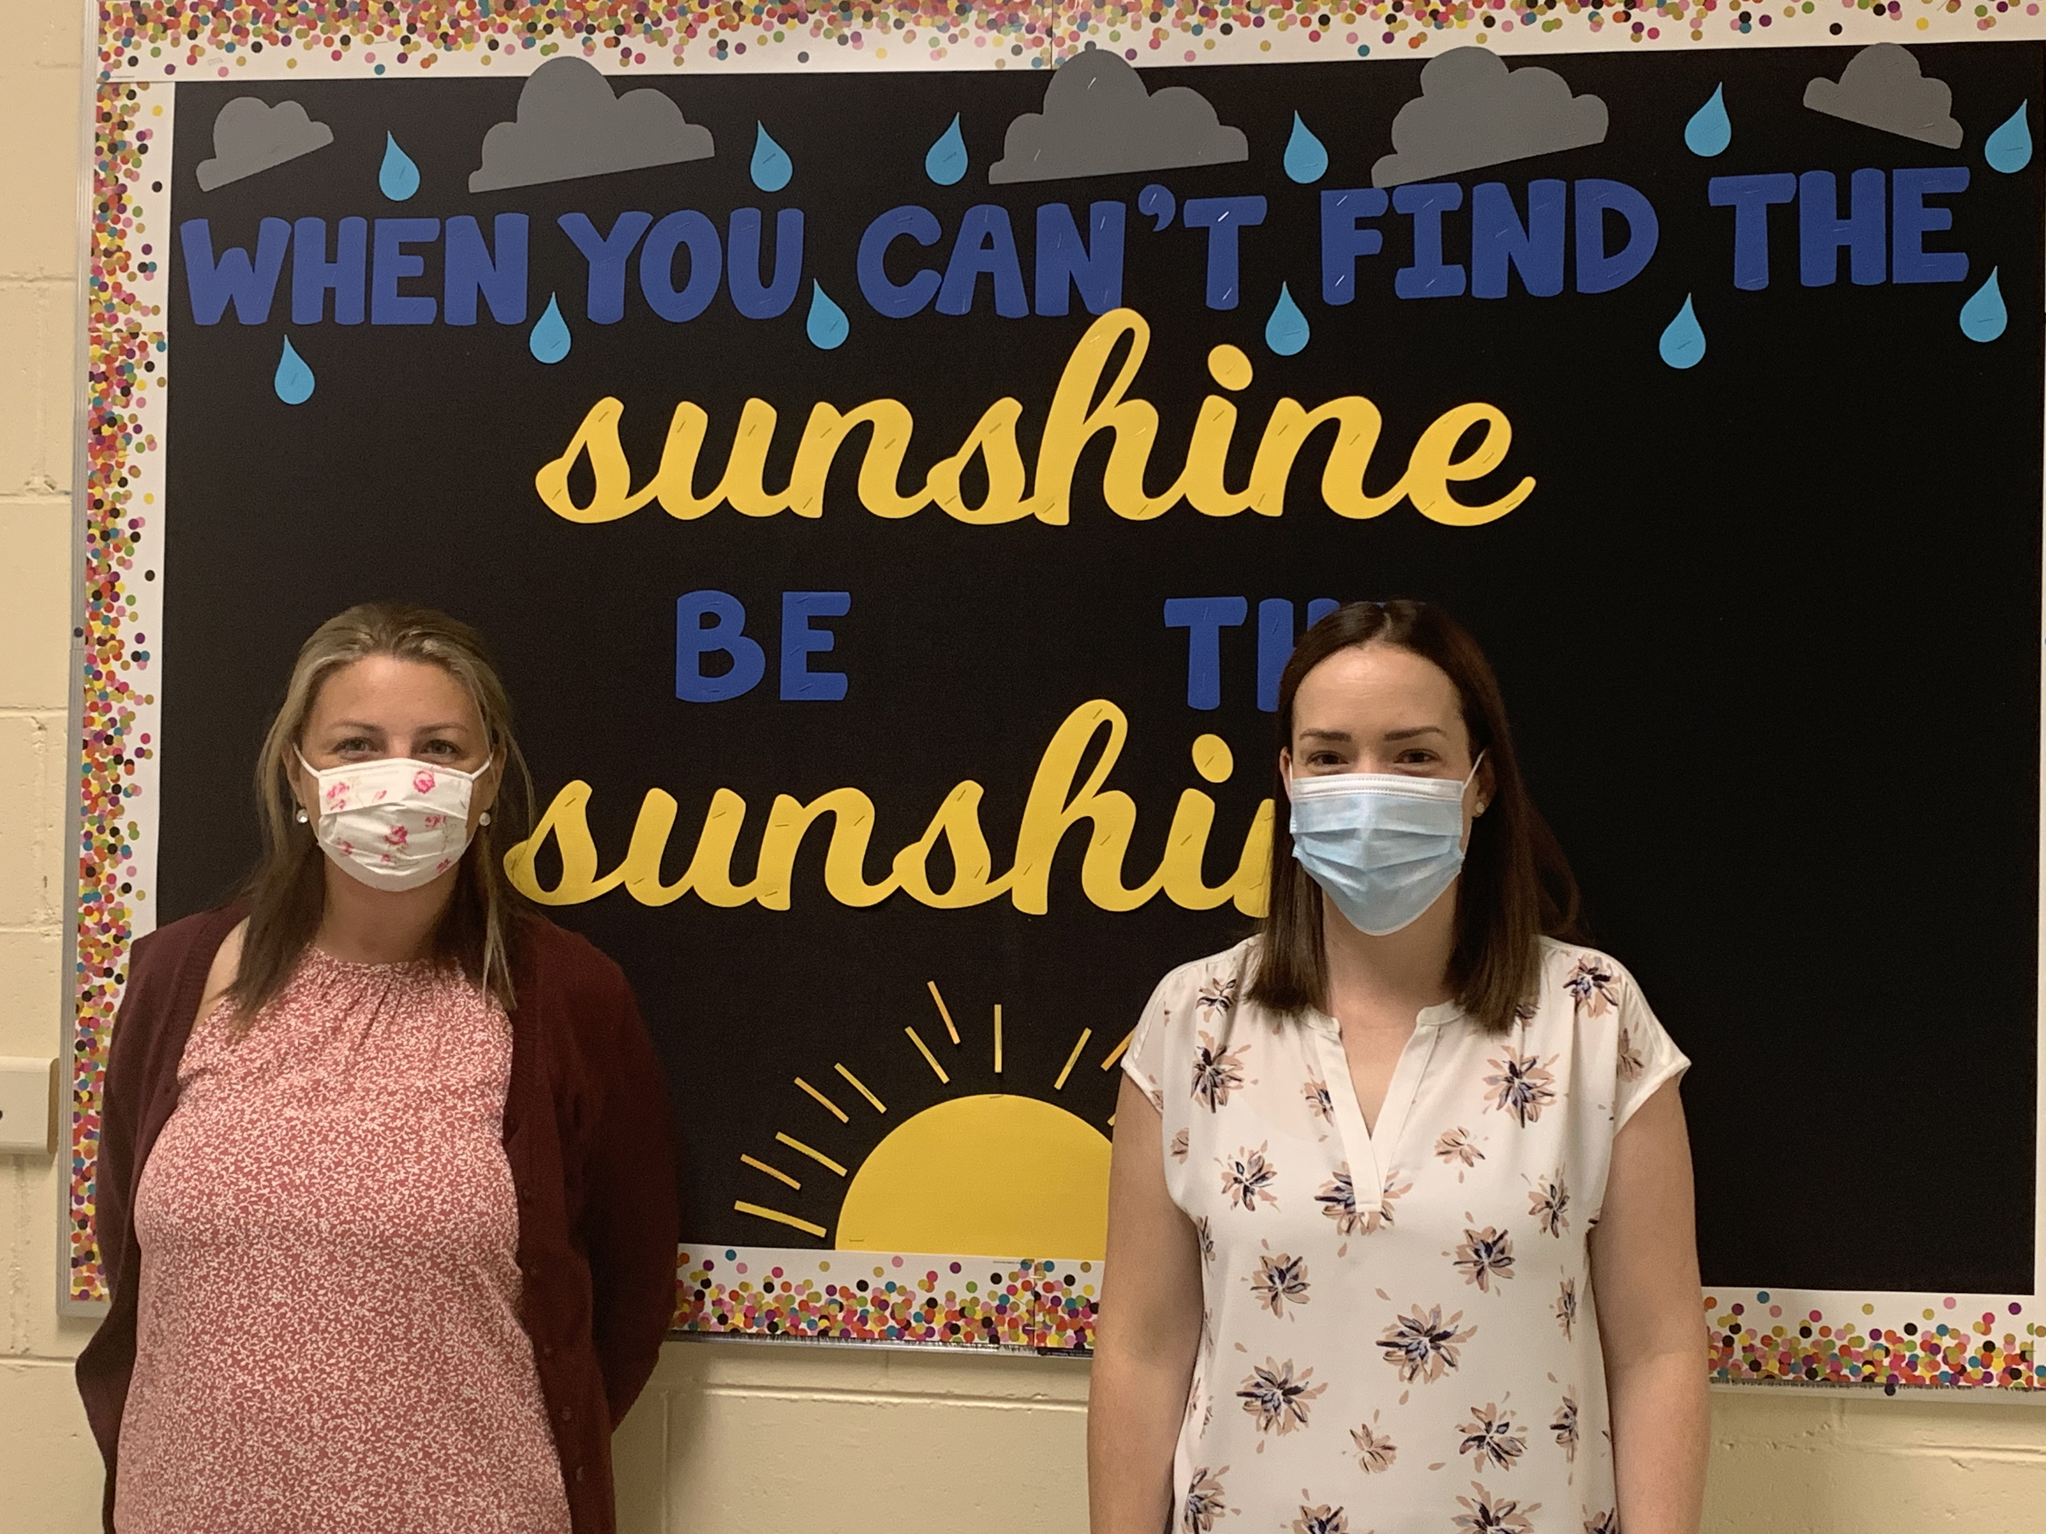
Mrs. Voutour (Guidance/Resource) Mrs. Keirstead (Resource)

Slide 18
EDUCATIONAL ASSISTANTS AT SUMMERHILL ELEMENTARY SCHOOL
Mrs. Basque Mrs. Mersereau
Mrs. Seeley Mrs. Pomeroy
Mrs. Sullivan Mr. Merlo
Mrs. St-Hilaire Mrs. Drummond
Mrs. Taylor Mr. Tynes
Mrs. MacBeth

Slide 19
COMMUNICATION -You should start with your child’s teacher if you have a concern -We do not have agendas this year, please call, write a note or send an email to your child’s teacher for communication

Slide 20
SCHOOL MESSENGER – reminders of upcoming events, school cancellations
@SummerhillSt - Pictures
and highlights of special events
and learning in the classroom
SCHOOL WEBSITE
http://summerhill.nbed.nb.ca - Documents, newsletters, School Improvement plan, more information about our school

Slide 21
SCHOOL CASH ONLINE AND BUSES
Mrs. Myrie – Will sign you up for CASH online
Will also help you with your child’s bus if you need help.
Please also check the Anglophone School District West website

Slide 22
Hours of Instruction
**Supervision for bus students begins at approximately 7:40 am, upon the arrival of the first bus**
Monday, Tuesday, Wednesday and Thursday
7:40 – 8:15 – Bus students arrive
8:05 – 8:20 – Walking students or students getting dropped off arrive at front door
8:20 am - Entrance Bell/Class Begins
***Walkers/Students getting picked up LEAVE the classroom at 2:55, then the Bus Students. Bus departure time is 3:05.
Friday – Dismissal at 12:00 (Walkers/Students getting picked up leave classroom at 11:55).

Slide 23
PICK UP AND DROP OFF
We have a very busy school with over 250 students and approx. 25 staff
There are 8 – 10 busses coming in and out
Drop off starts at 8:05 a.m.
Please use parent drop off lane (front of building)
Please do not drive through the Bus Loading Zone at any time
For pick up, please wait in the parking lot. Students will be coming out the front door and lining up on pavement
Check call the office ahead of time if you are coming early to pick your child up

Slide 24
RULES TO FOLLOW:
Allergy Alert – Peanut – free / scent – free
If students pack toys or technology in book bags – they must keep them there throughout the day
Personal cell phones/Ipads – should not be used in the school day

Slide 26
Everyone will receive a postcard copy of this with the School Handbook!

Slide 27
We need to make the positives so loud that the negative becomes almost impossible to hear.
George Couros

